Slide 1
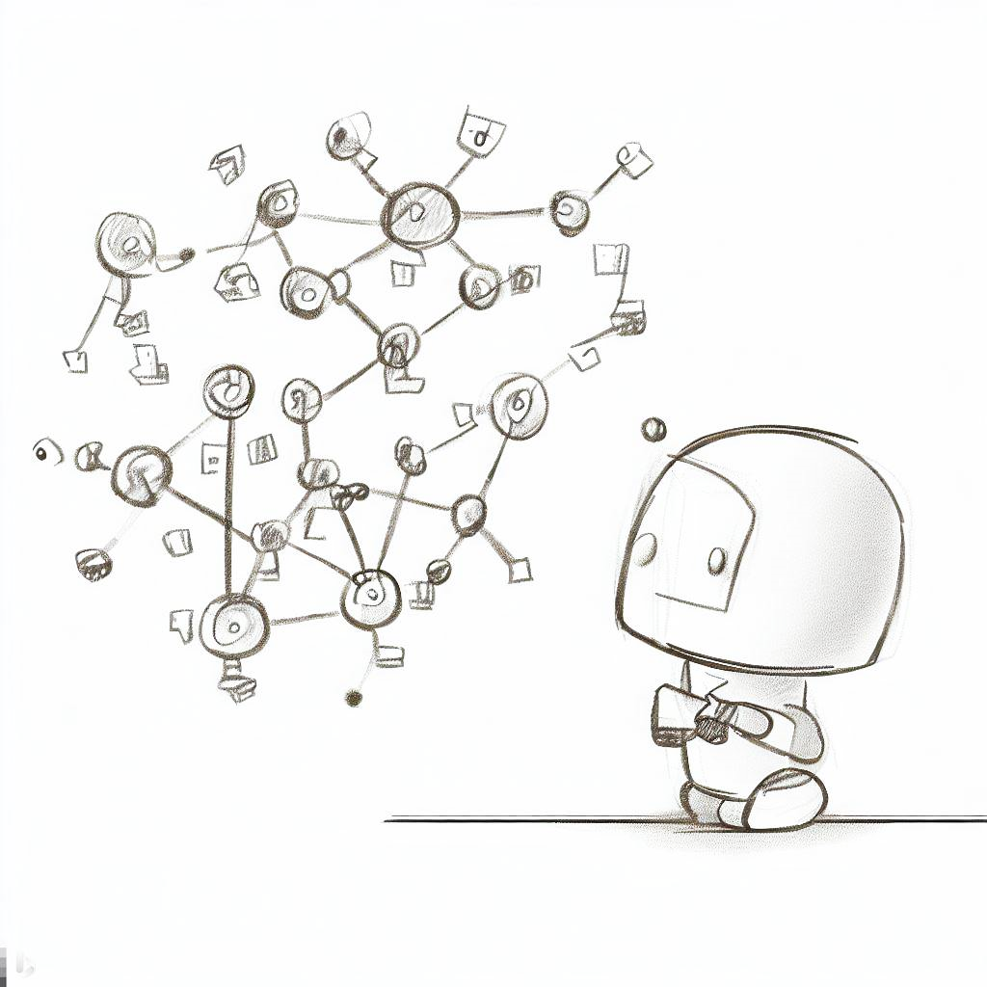
Interactive and Scalable Visualization for Directed Cyclic Message Graphs
… by the example of Robot Operating System 2 Networks.
Valentin Schröter | Supervisor: Willy Scheibel
Interim Presentation of the Master’s Thesis

Slide 2
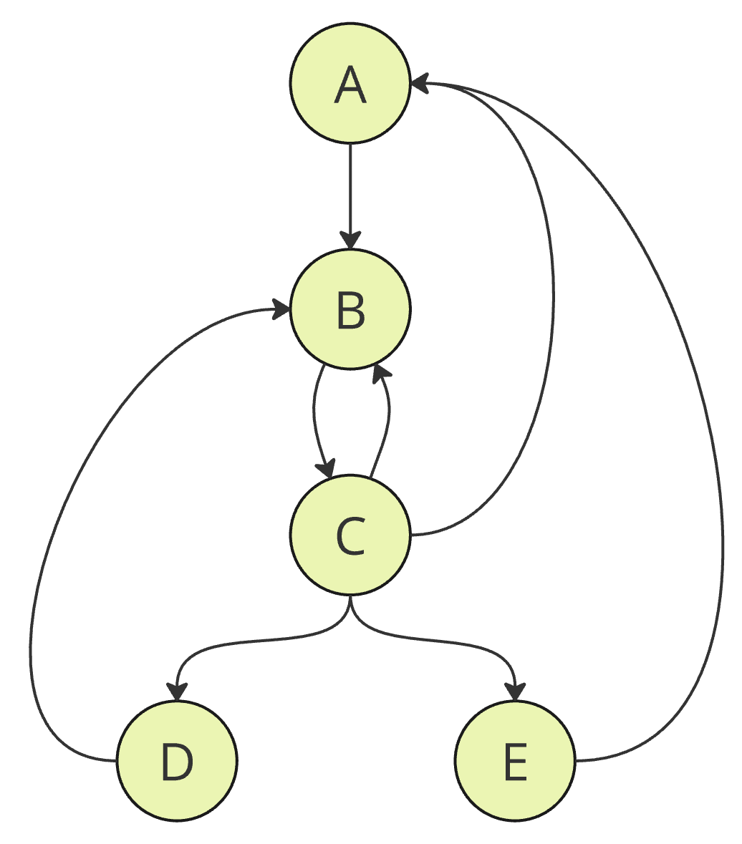
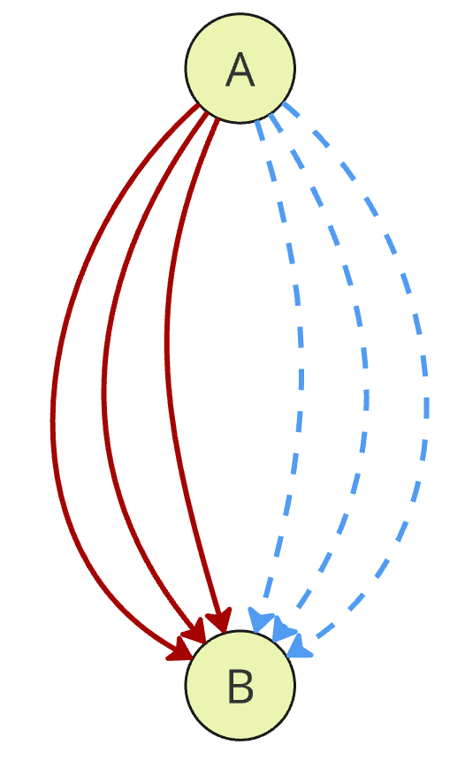
Directed Cyclic Message Graphs
Directed Cyclic Graphs
&
Message Graphs
Begriff “Multi” mit rein
besser: Graph
ohne Eigenschaften
arbitrary graph
structure
multiple connections between nodes
→ ~ 1-50 connections per node
possibly different
communication channels
(e.g. UDP vs. TCP)
Zoom in andeuten

Slide 3
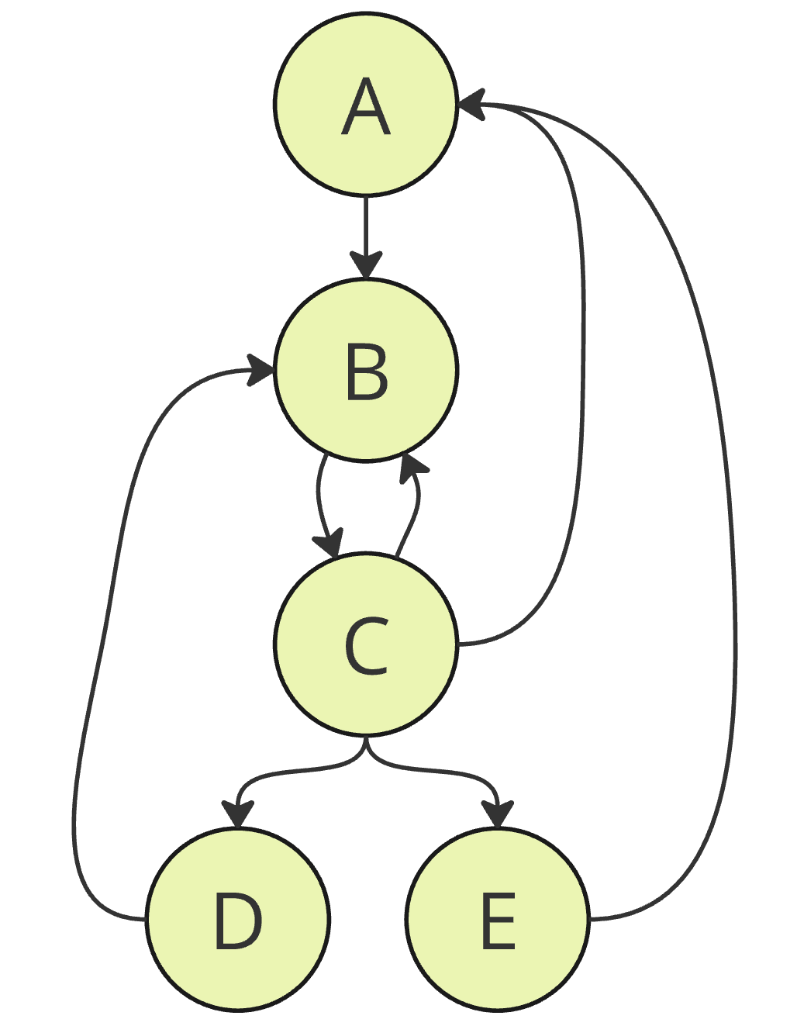

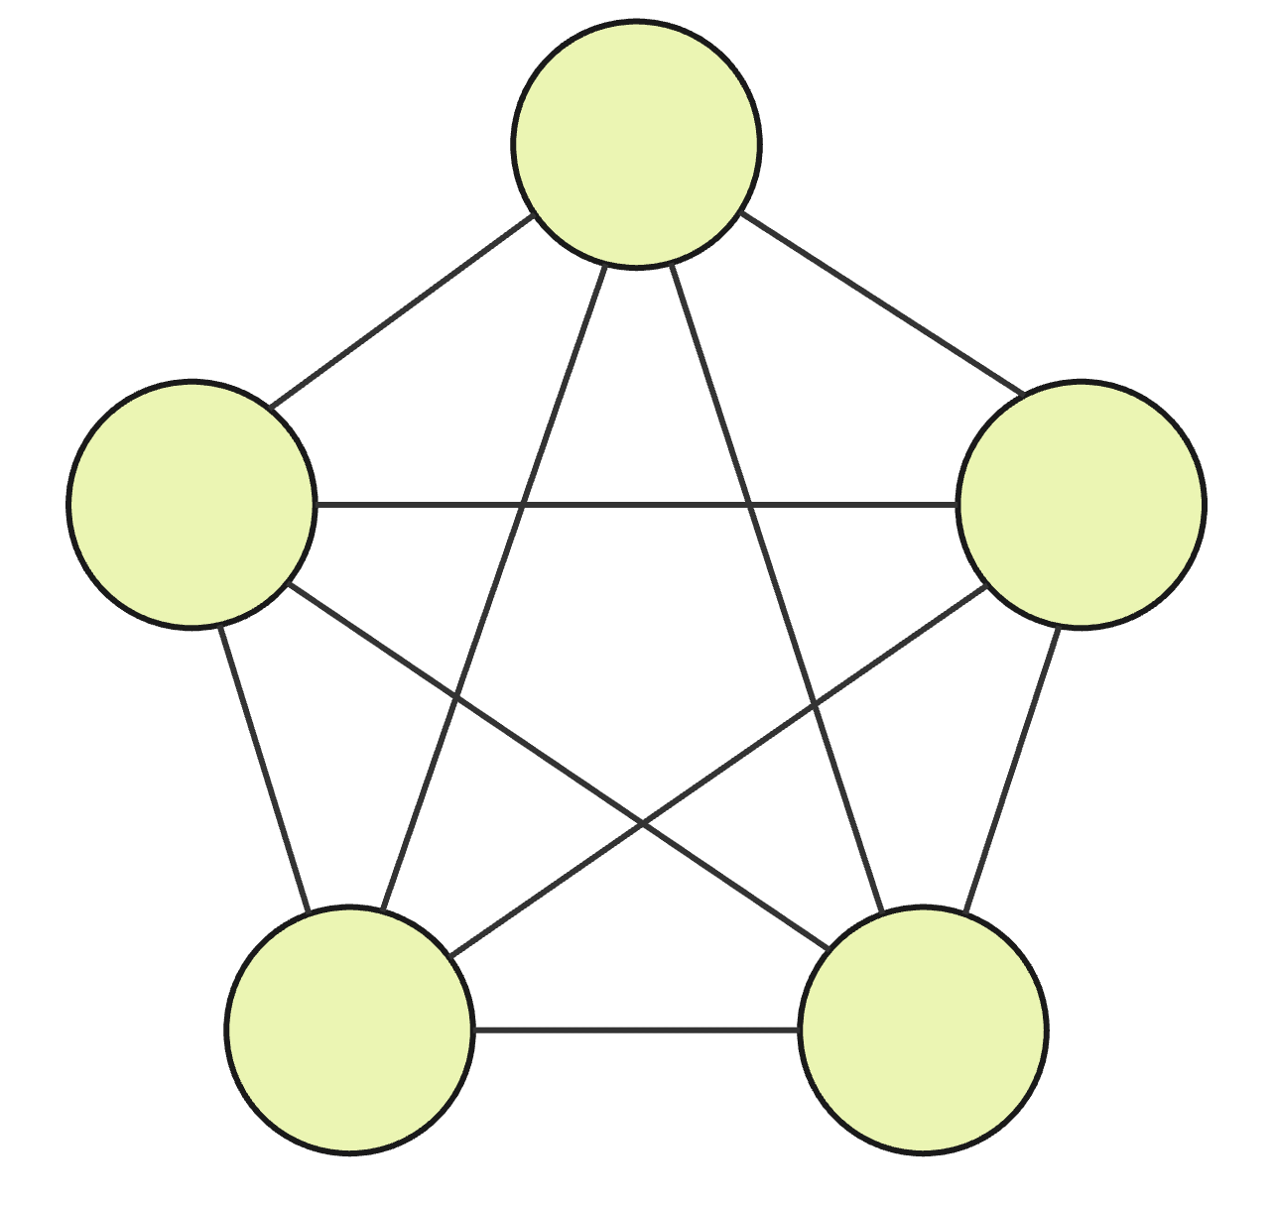
Directed Cyclic Message Graphs
besser: Graph
ohne Eigenschaften
arbitrary graph structure (especially with cycles and bidirectional connections)
Characteristics
multigraph
(multiple connections between node-pairs; m >> n)
fully connected parts
in the graph
(due to broadcast mechanisms)
of node-based communication networks
no explicit hierarchies or group memberships
(at least not assumable)

Slide 4
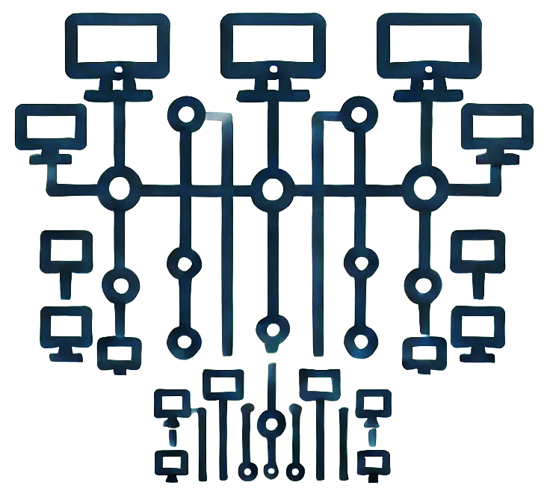




Related Work:
Where to find Message Graphs?
Robotics
other distributed
systems / communication networks
Robot Operating System
[Quigley et al. 2009] & [Macenski et al. 2022]
e.g. computer networks with Web-APIs / microservices / etc.
IoT
…we have
data for this!
[mqtt-v5.0 OASIS 2019]

Slide 5
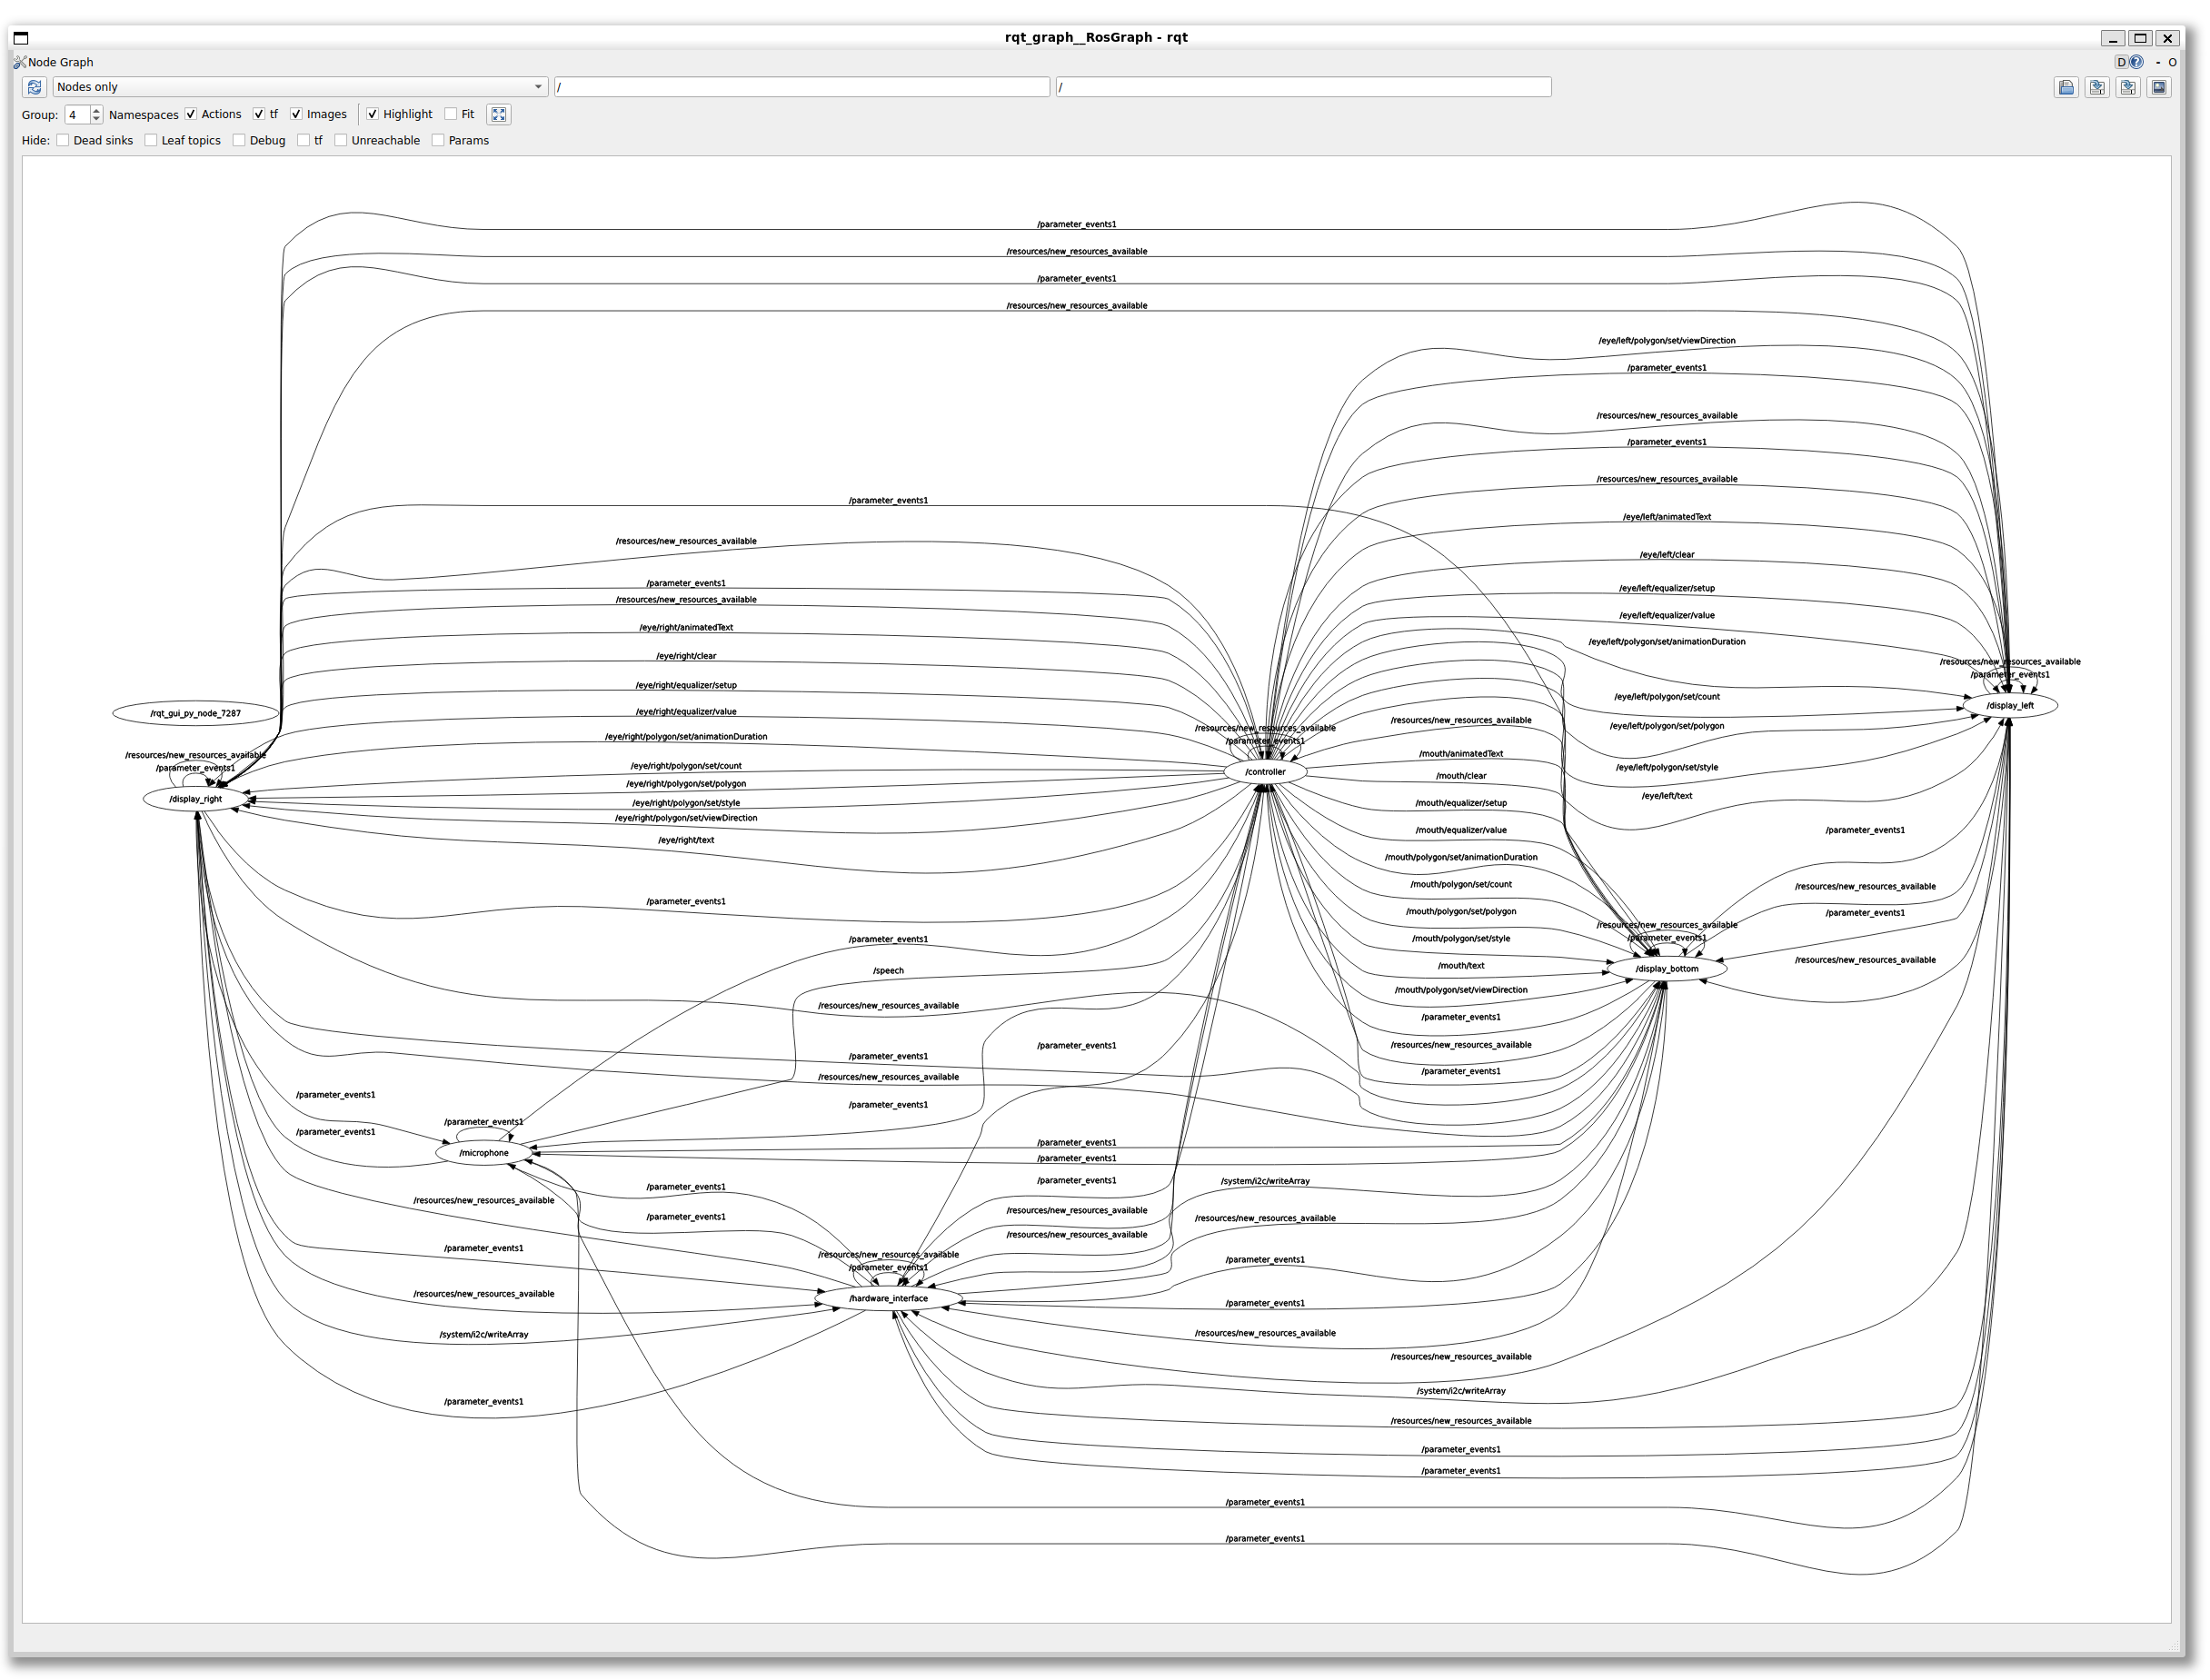

State-of-the-Art Visualizations
Daten zur Abbildung, n und m
rqt_graph: Visualizing the ROS computation graph (https://wiki.ros.org/rqt_graph)

Slide 6
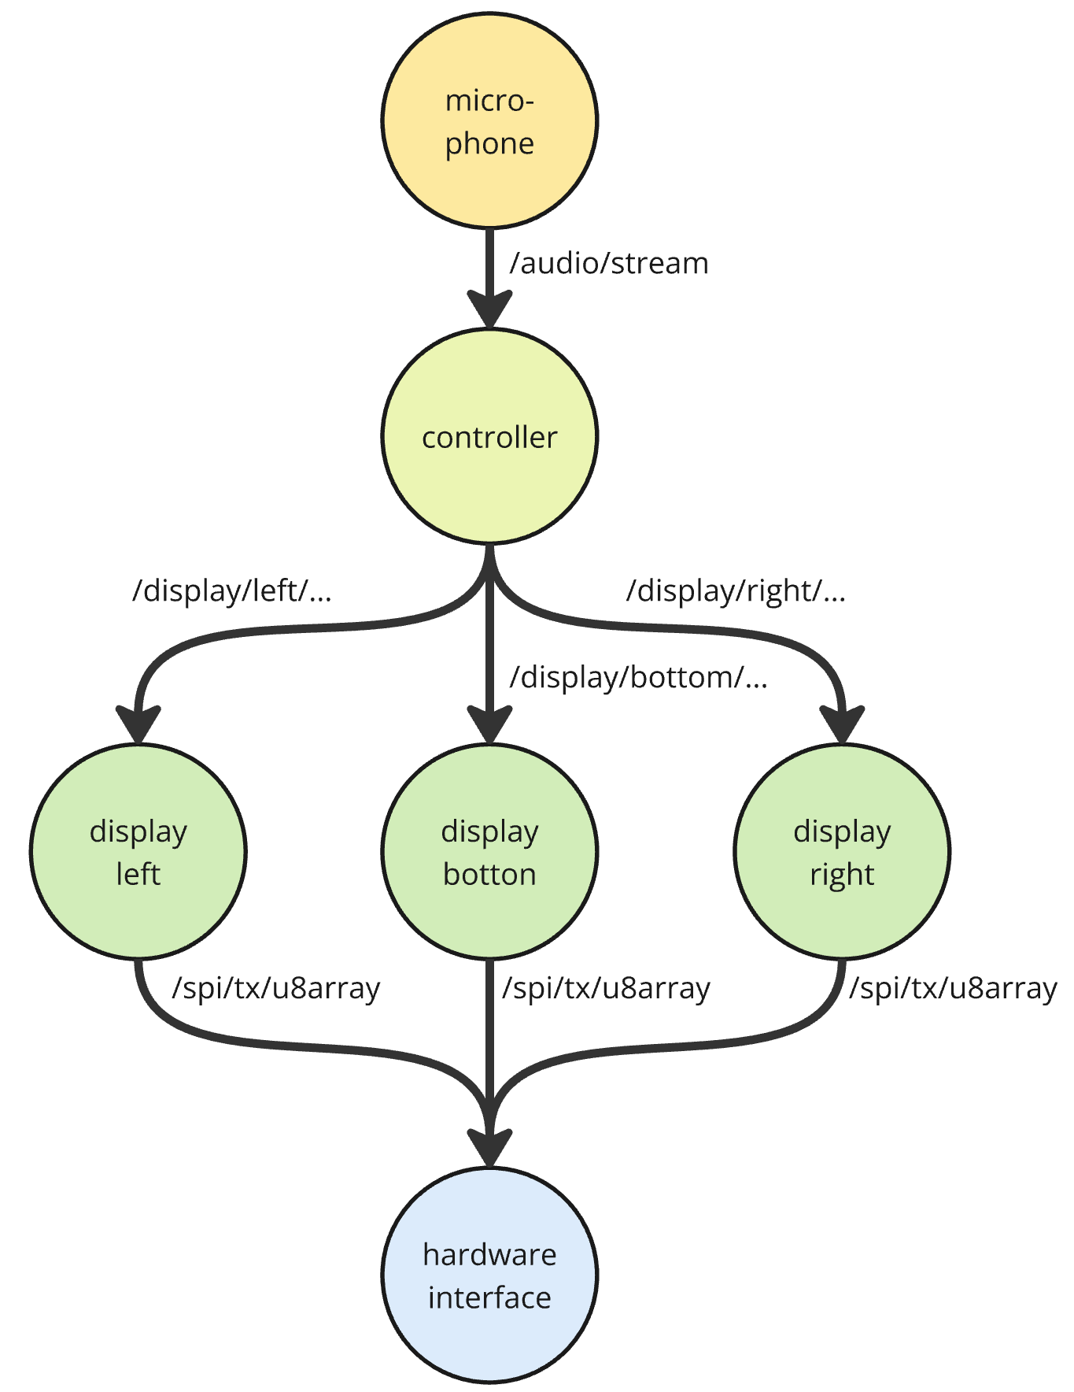
State-of-the-Art Visualizations
What it actually does →
Kanten highlighten
ggf. Knoten zuordnen
rqt_graph: Visualizing the ROS computation graph (https://wiki.ros.org/rqt_graph)

Slide 7
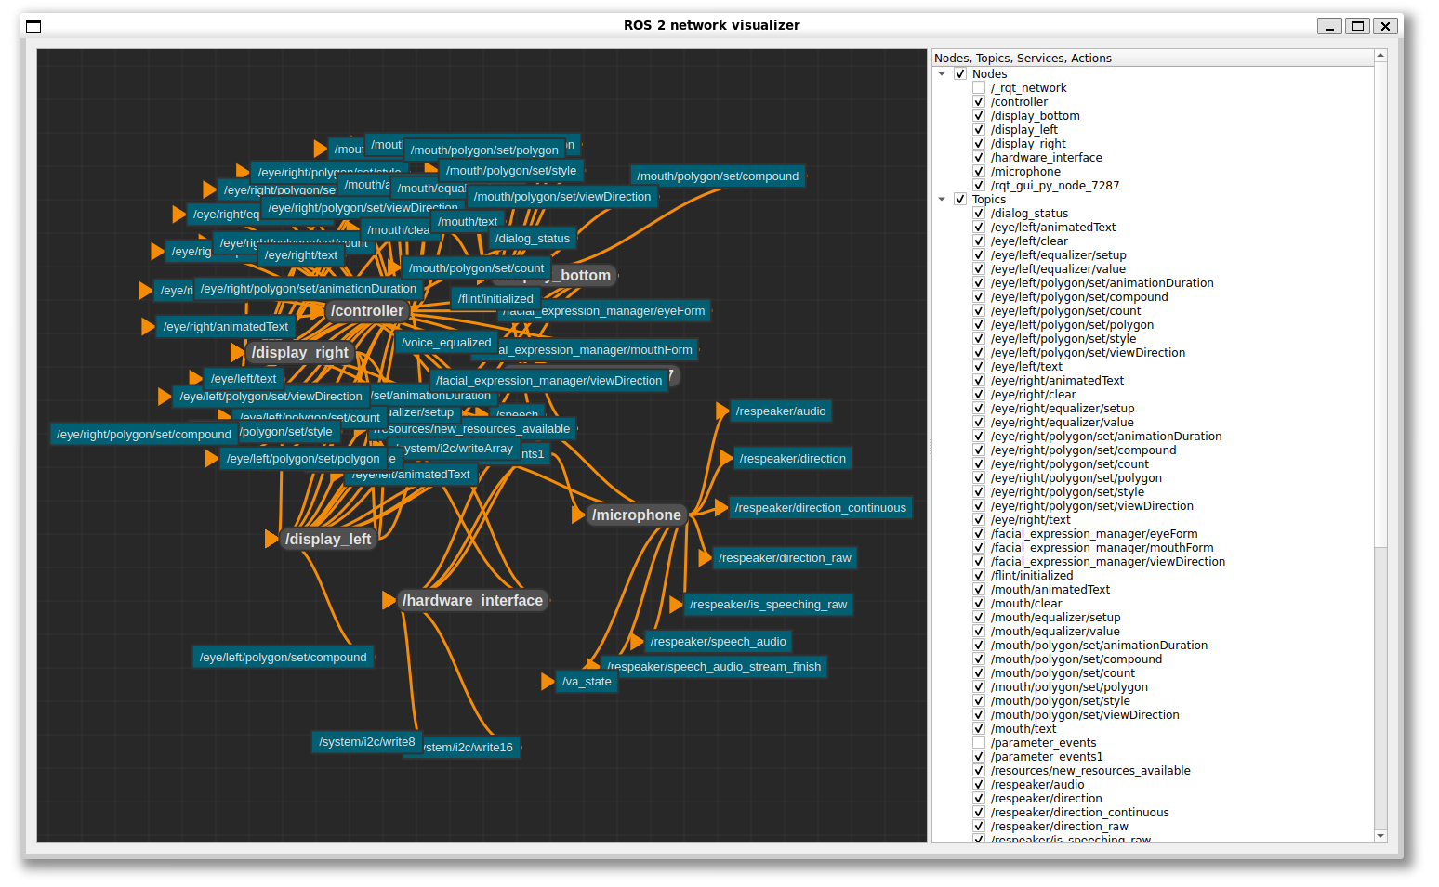
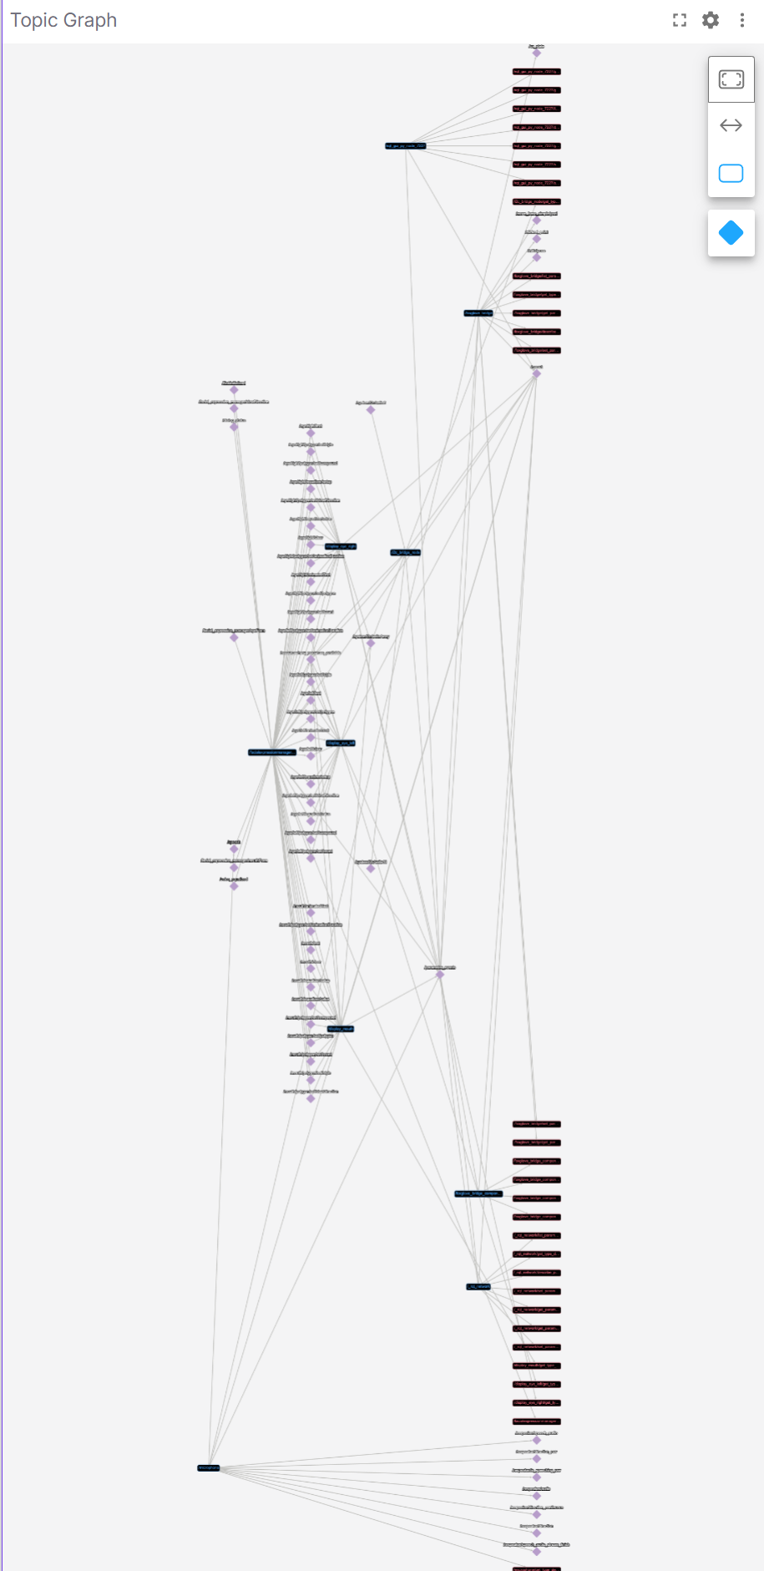
State-of-the-Art Visualizations
mehr aufräumen
ros_network_viz (https://github.com/ros2/ros_network_viz)
foxglove studio (https://docs.foxglove.dev/docs/visualization/panels/topic-graph/)

Slide 8

Motivation for the Master‘s Thesis
8
siehe oben
better Synonyme: usable
arbitrary graph structure
Message Graphs
How to create a better visualization for message graphs?
multigraph
Clarity?
fully connected parts
Better in terms of
Comprehensibility?
no explicit hierarchies
Scalability?
visual scalability
über Gegenrichtung nachdenken
Visualization for Message Graphs - Master's Thesis Valentin Schröter
16 December 2024

Slide 9
Motivation for the Master‘s Thesis
dataflows
understand the structure of the graph
dependencies
Why visualizing the network itself?
topologies
support the development process
identify communication patterns
unconnected parts
bottlenecks
available communication topics & channels
see details on demand
message types

Slide 10
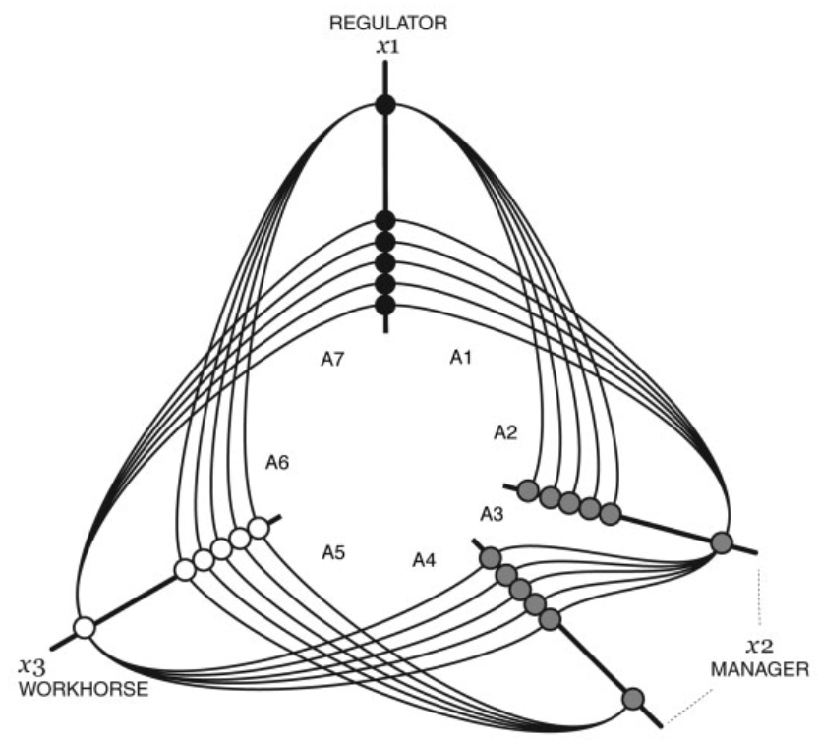
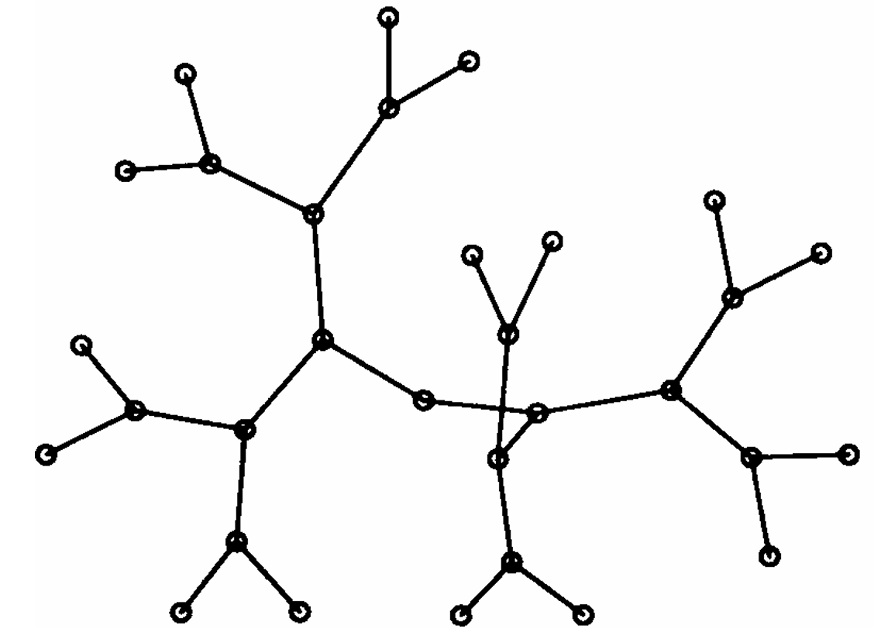
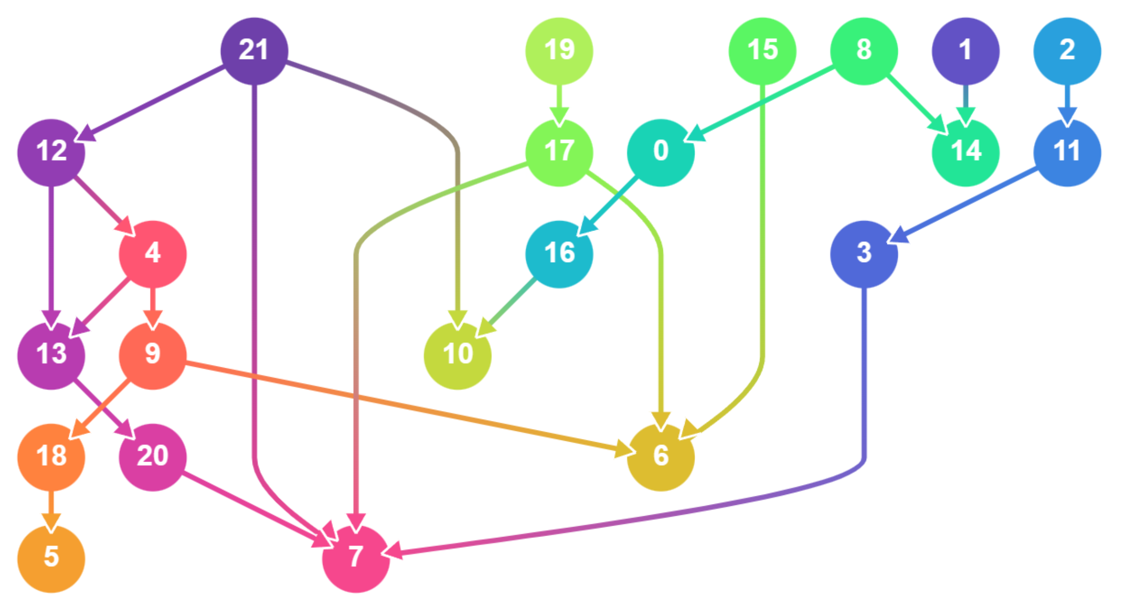
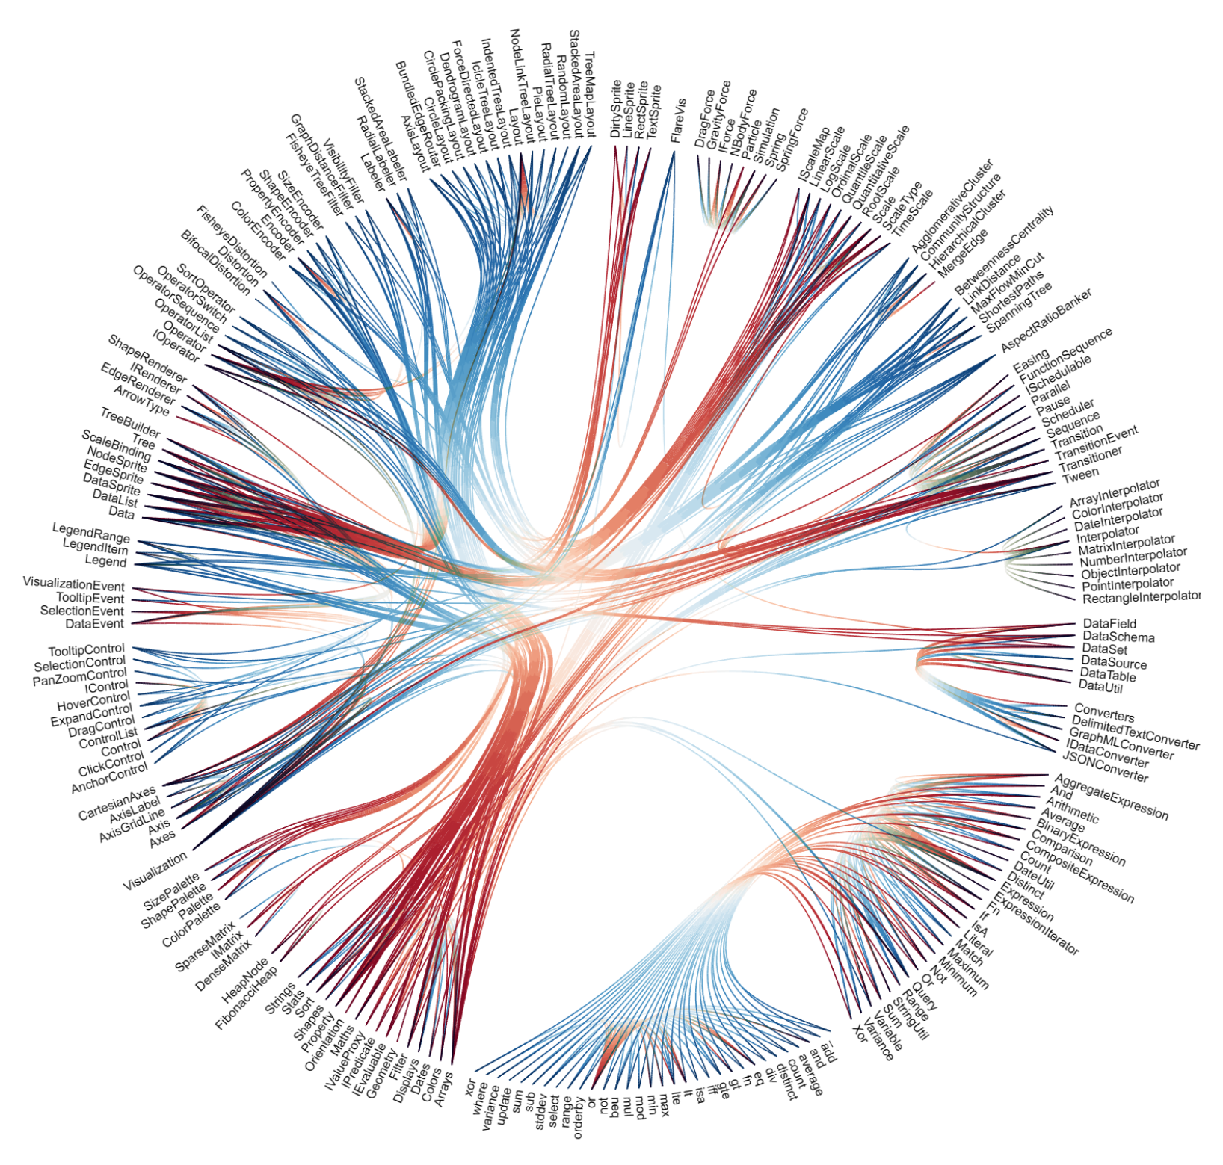
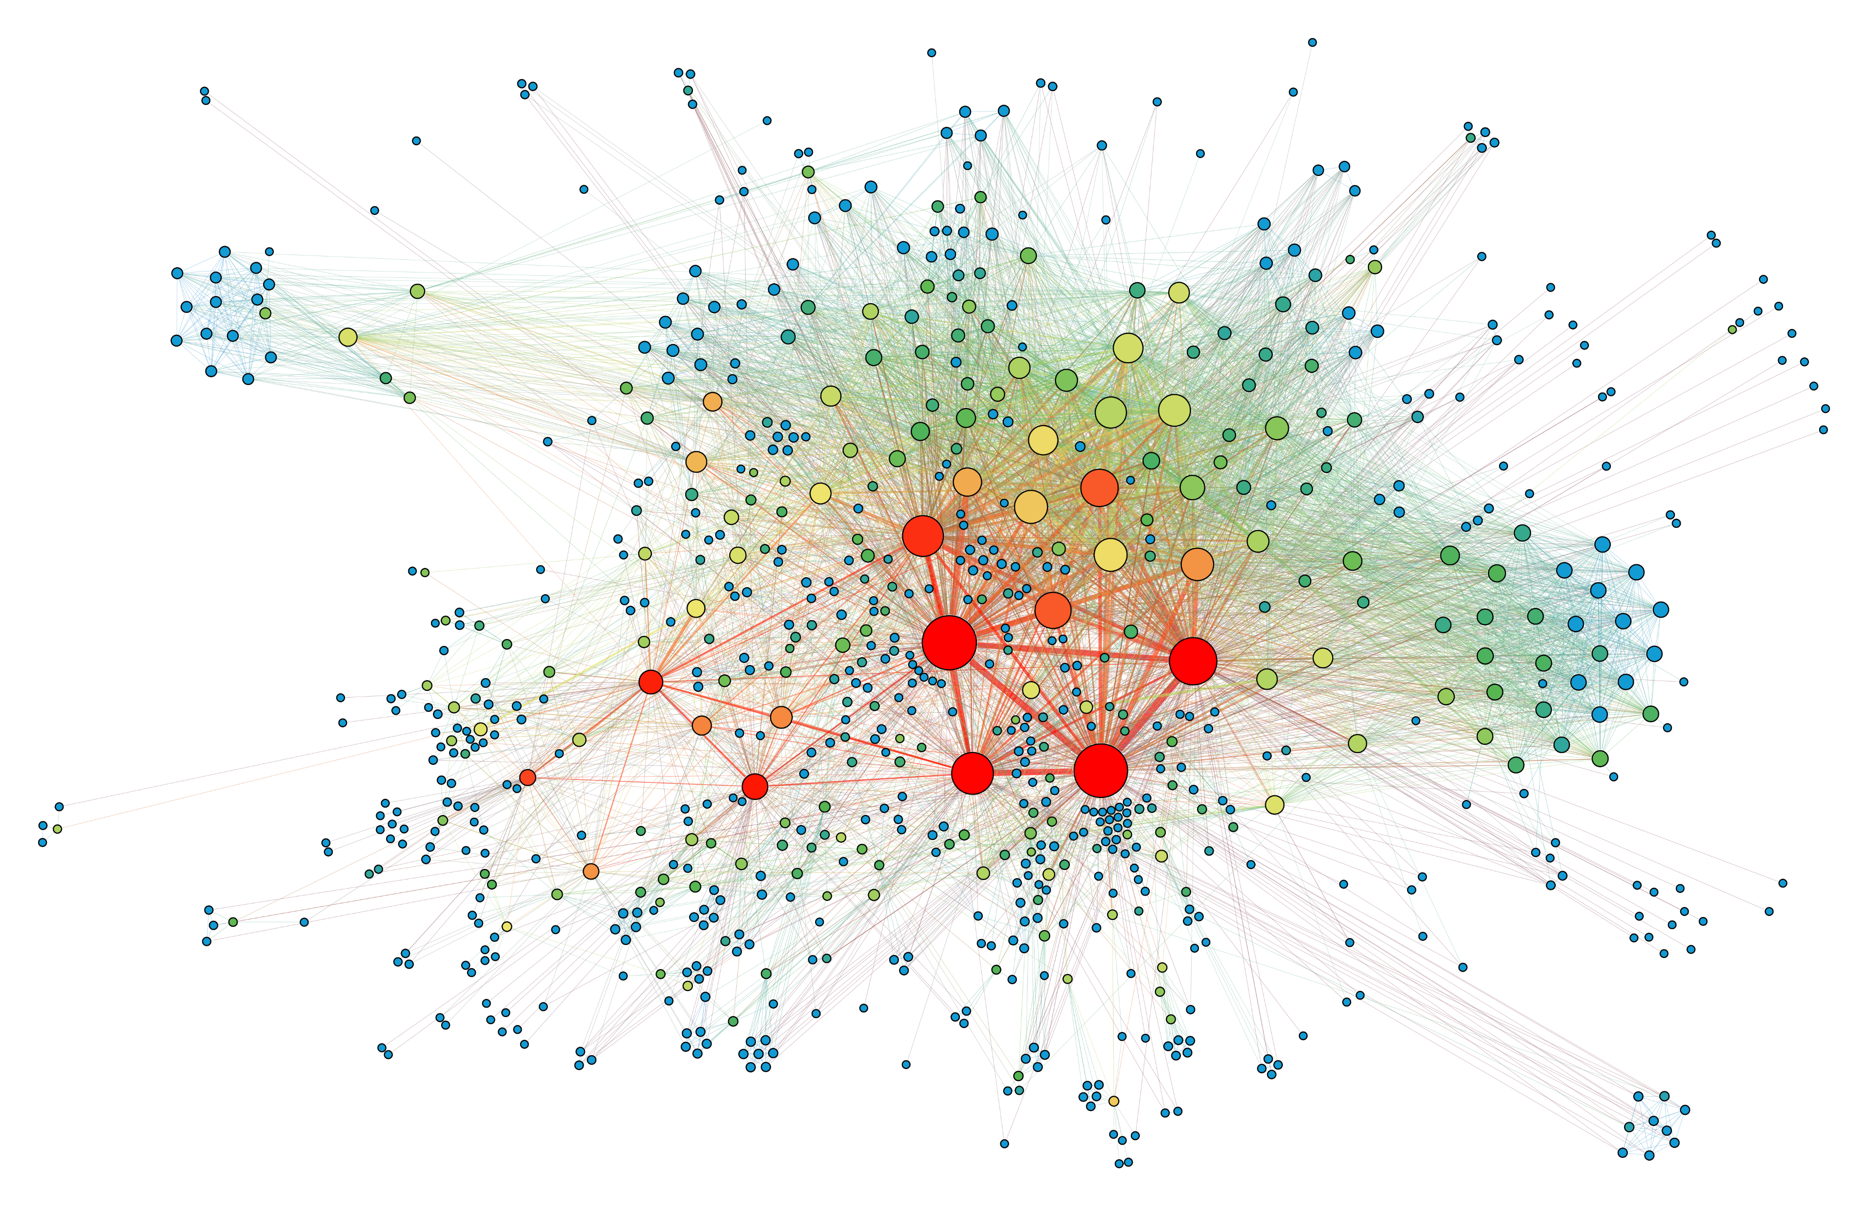
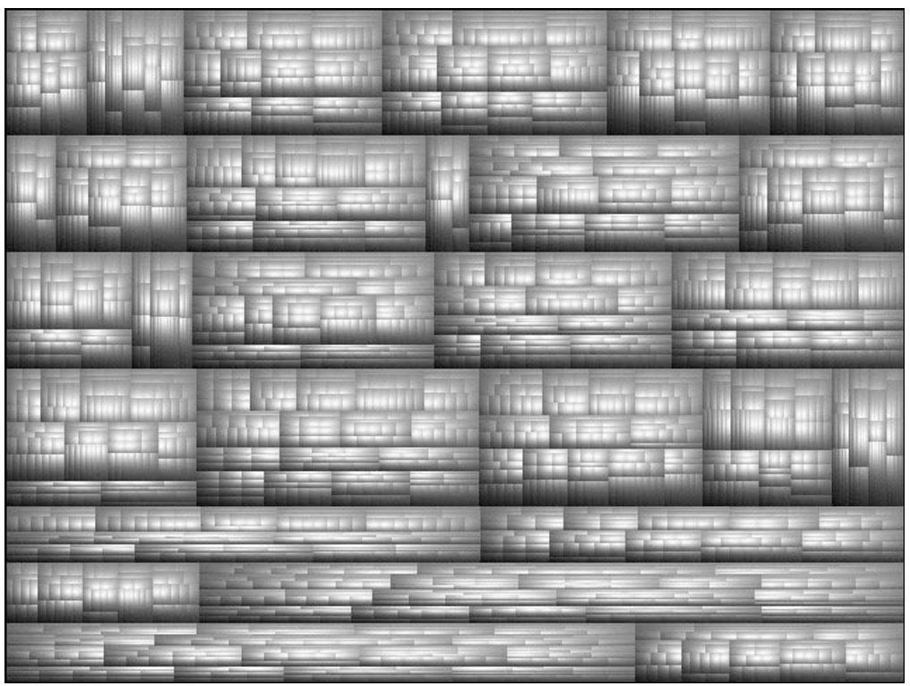
Related Work: Existing Visualization Techniques
Layouts based on hierarchies or communities
Layouts based on forces
iwo erwähnen, dass
keine Planarität erwartbar
Jahr dazu!
Scalable!
Applicable?
Sugiyama, Tagawa, and Toda, “Methods for Visual Understanding of Hierarchical System Structures.” 1981
Fruchterman and Reingold, “Graph Drawing by Force‐directed Placement.”
Problem:
No hierarchies & no clusters assumable!
Krzywinski et al., “Hive Plots--Rational Approach to Visualizing Networks.” 2012
Holten, “Hierarchical Edge Bundles.” 2006
Van Wijk and Van De Wetering, “Cushion Treemaps.” 1999

Slide 11
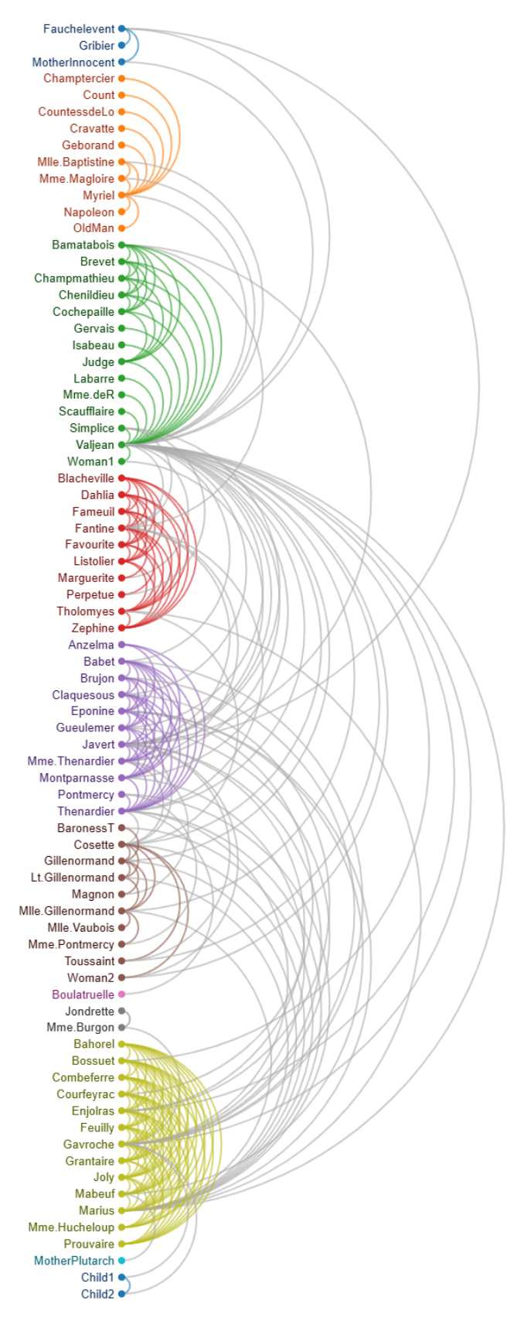
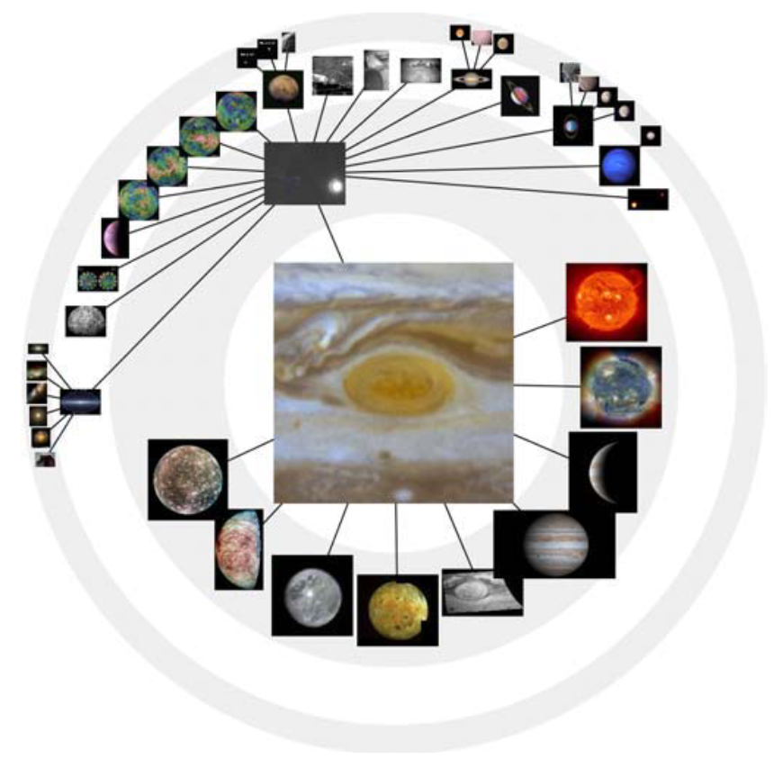
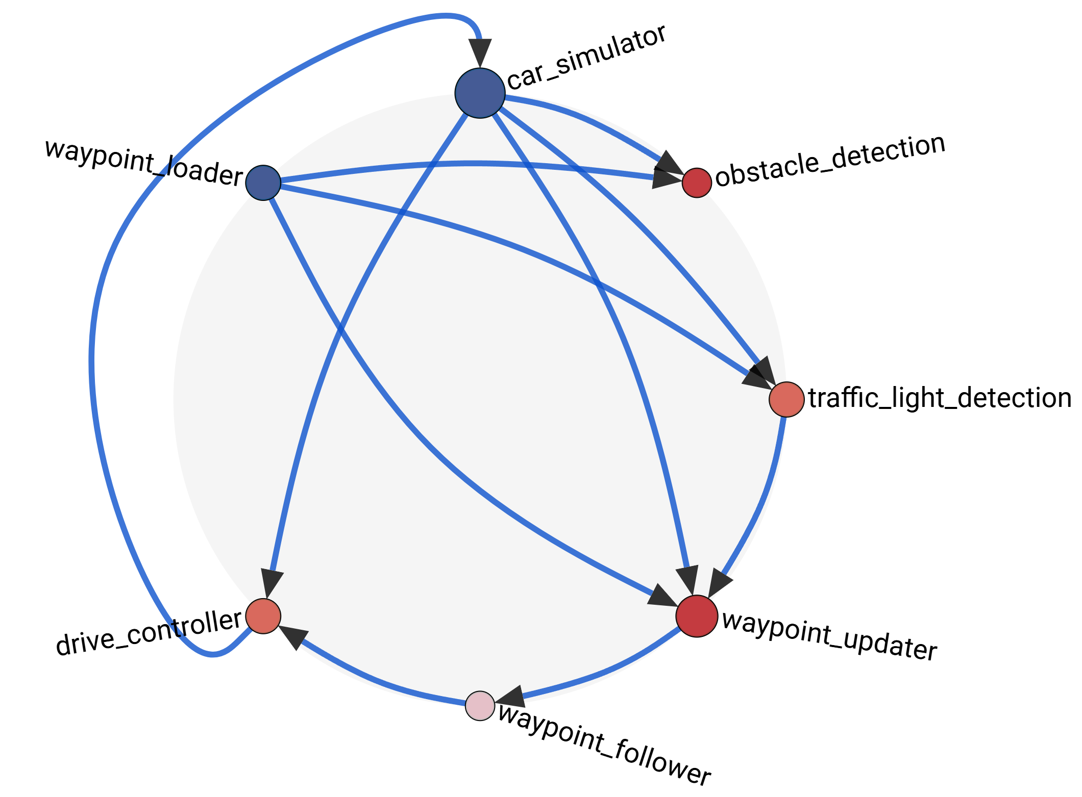
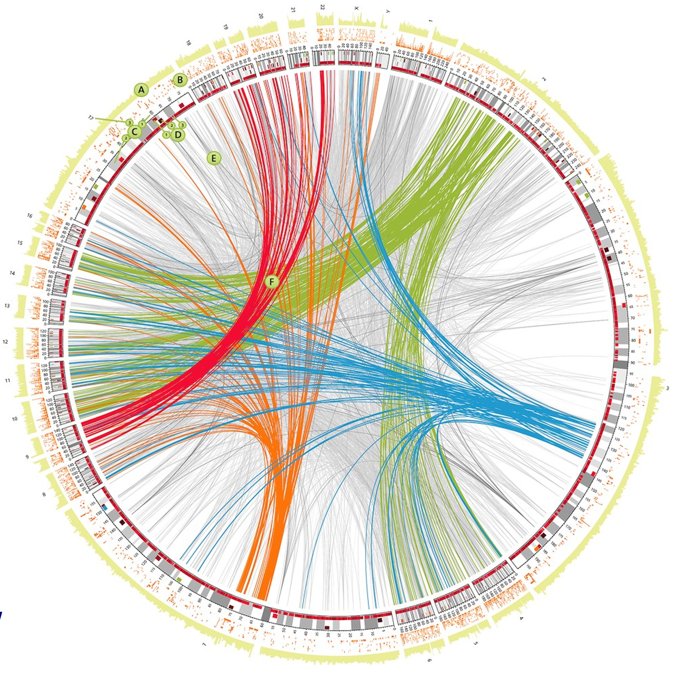
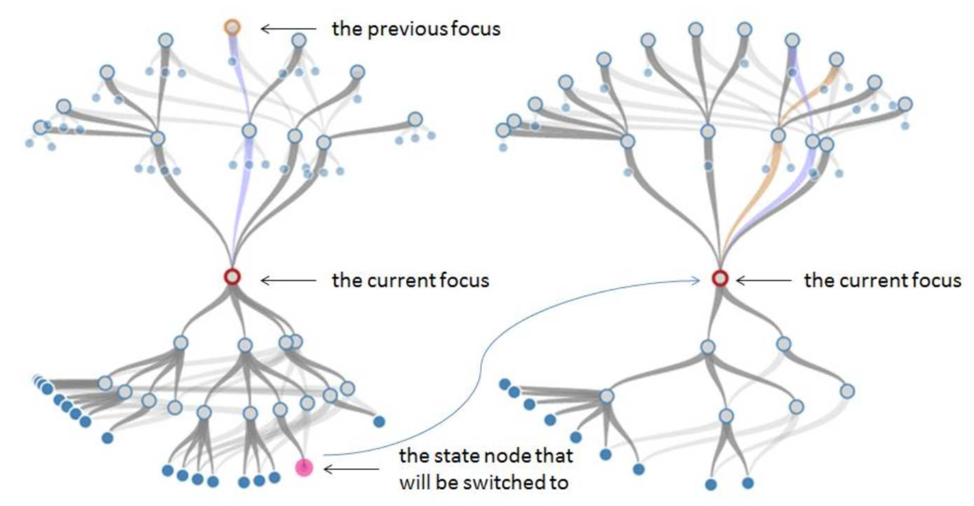
Related Work: Existing Visualization Techniques
Layouts based on 1D-Sorting
Focus+Context Visualization
MTVA Prototype!
Avoids Node-Edge Crossings
Jankun-Kelly and Kwan-Liu Ma, “MoireGraphs.”
Krzywinski et al., “Circos.” 2009
Scalability?
Greilich, Burch, and Diehl, “Visualizing the Evolution of Compound Digraphs with TimeArcTrees.” 2009
Zhang et al., “Analyzing Data Flow Diagrams by Combination of Formal Methods and Visualization Techniques.” 2018
Schröter, “Visualization of the communication graph of nodes in a RobotOperation System (ROS2) system” 2023

Slide 12
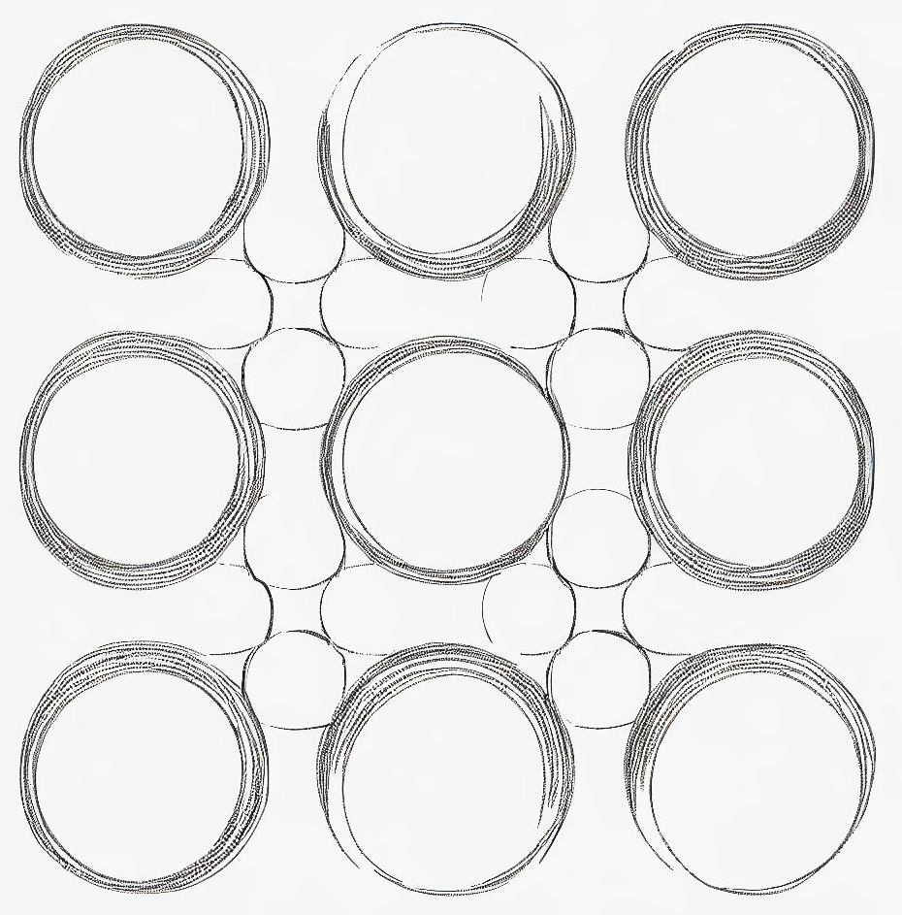
Content of the Master’s Thesis

Slide 13

Implement a Scalable Visualization
… to improve this!
1
reduce information overload for message graph visualizations
2
increase scalability & comprehensibility
3
provide details on demand

Slide 14
Proposed Visualization Pipeline
Begriff überall anpassen
Syntactic Graph Analysis
1
reduce information overload for message graph visualizations
Data Aggregation
Information Aggregation
2
increase scalability & comprehensibility
Flow Sorting
Node Clustering
Community Detection
Stauchen, damit 3 hinter Focus+Context steht
3
provide details on demand
Hierarchical Layouting
Focus+Context Visualization

Slide 15
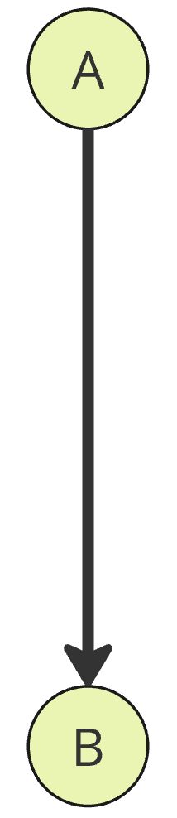
Data Aggregation
Syntactic System Analysis
Information Aggregation
aggregate
multi-edges
Flow Sorting
Node Clustering
Community Detection
Hierarchical Layouting
Focus & Context Visualization
Reminder: What unaggregated edges look like

Slide 16
Data Aggregation
Syntactic System Analysis
Information Aggregation
aggregate
multi-edges
Flow Sorting
Node Clustering
Community Detection
Hierarchical Layouting
Focus & Context Visualization
sufficient?

Slide 17
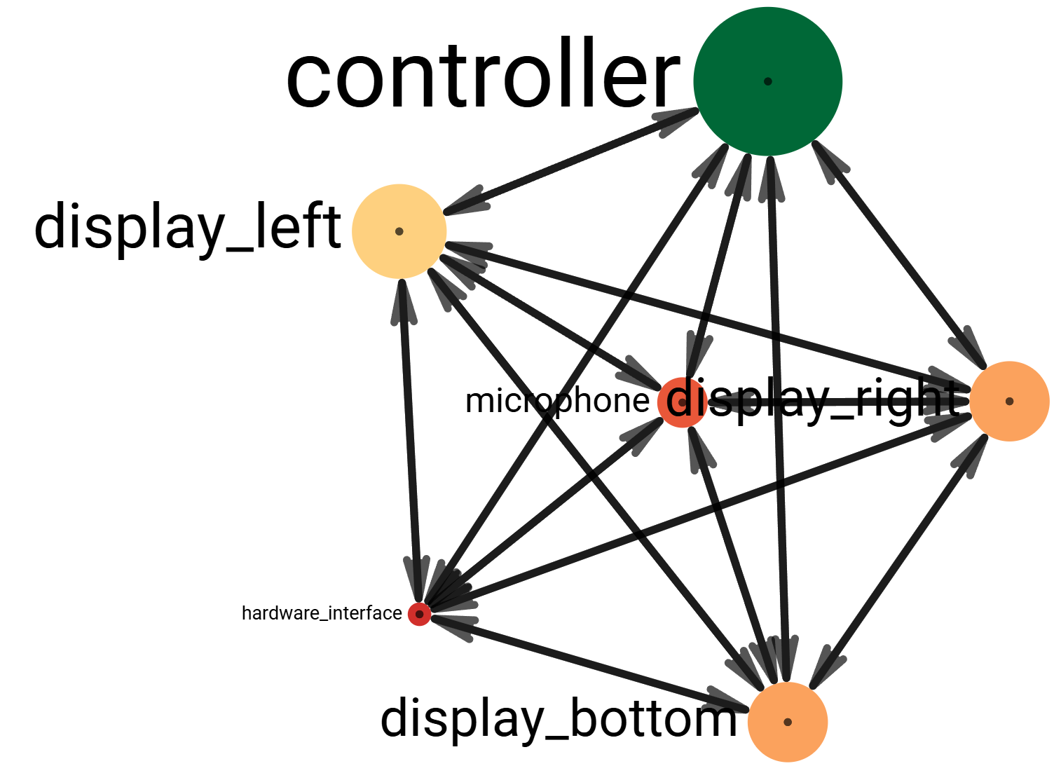
Data Aggregation
In our expectation
In reality
Syntactic System Analysis
Information Aggregation
Flow Sorting
Node Clustering
Community Detection
Schrift kleiner
Hierarchical Layouting
Focus & Context Visualization
Problem: Fully-connected characteristics of message graphs

Slide 18
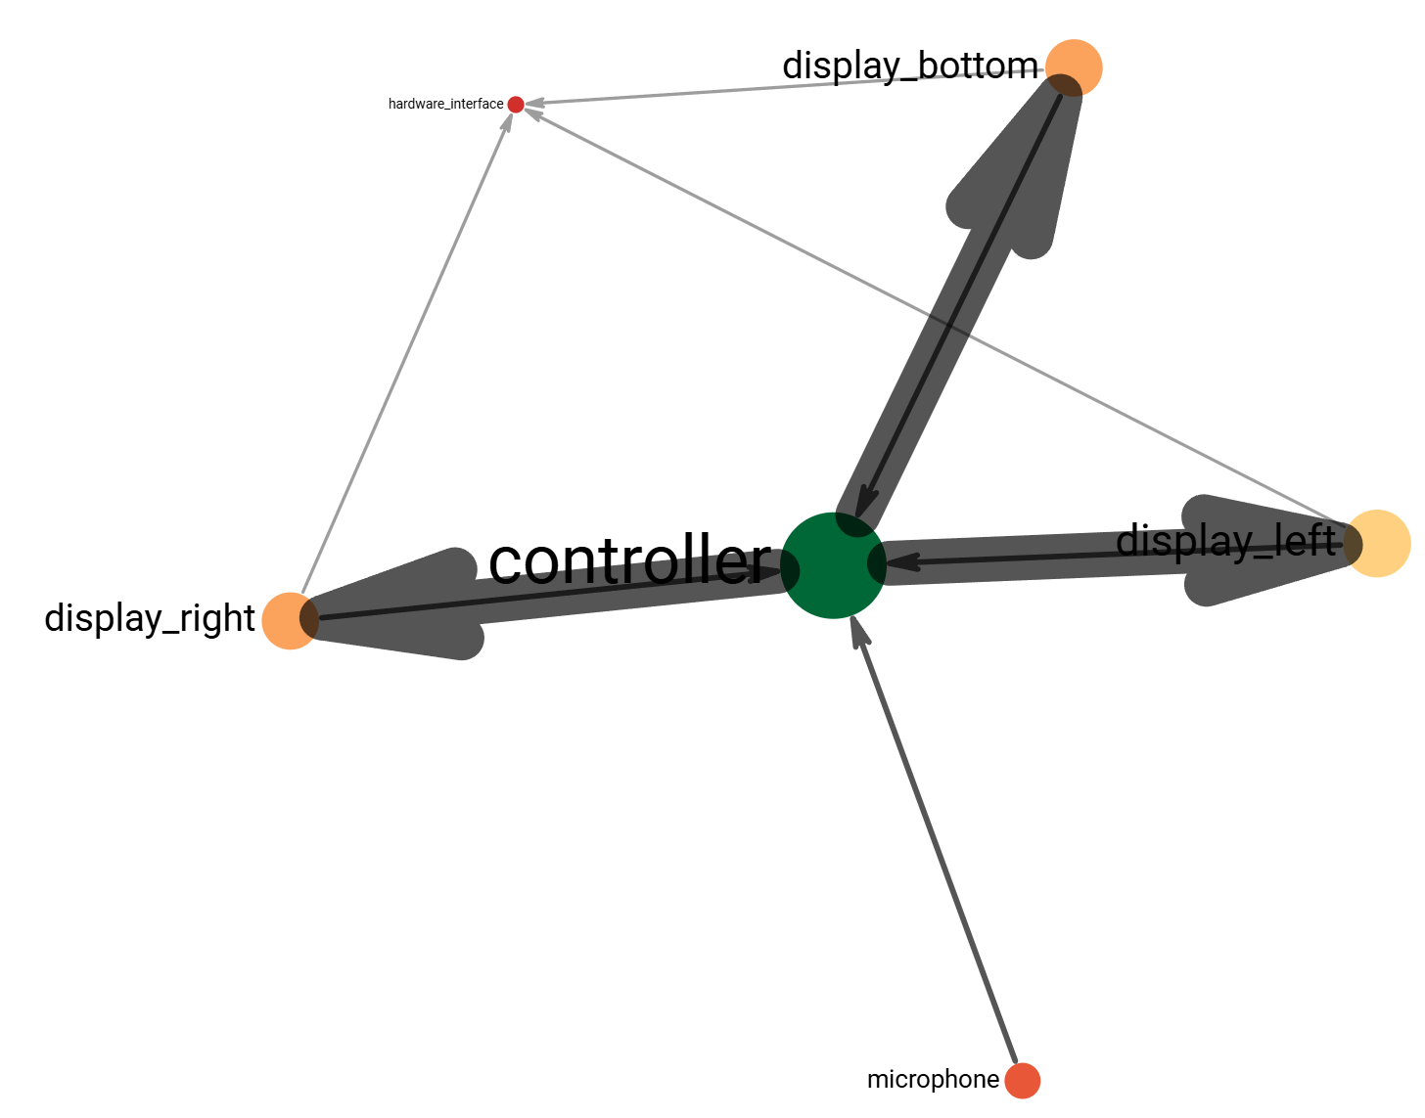
Syntactic Graph Analysis
Filter out irrelevant connections (e.g. broadcast events, health checks, etc.)
Syntactic System Analysis
Information Aggregation
Flow Sorting
Node Clustering
Community Detection
Hierarchical Layouting
Focus & Context Visualization
Frage: ist Platzierung sinnvoll?
ggf. kurze Notiz & Backup Slide zu worauf das beruht

Slide 19

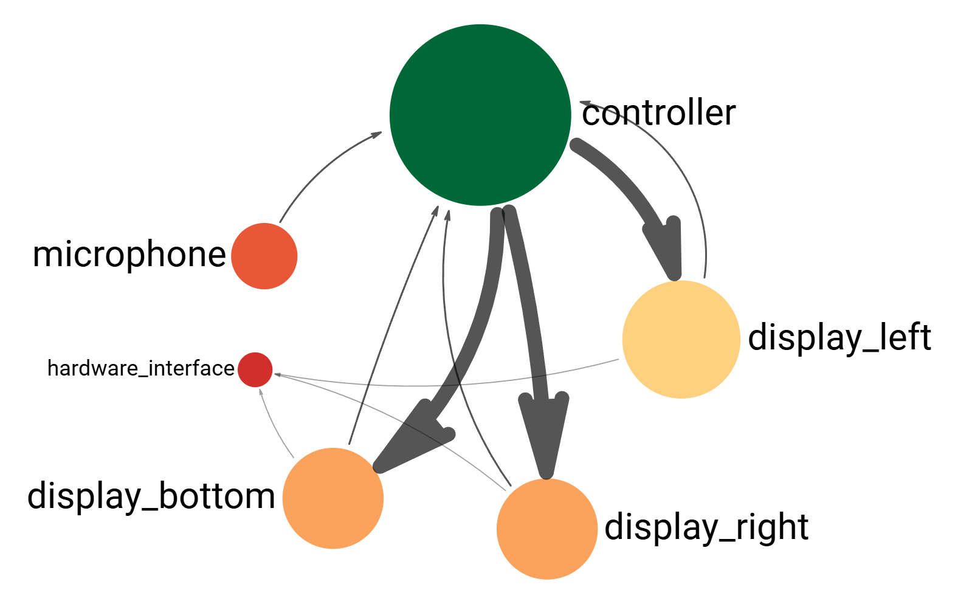
Flow Sorting
Rückkanten, die im Hand-Layout nicht drinnen sind
Syntactic System Analysis
Information Aggregation
Flow Sorting
Node Clustering
Community Detection
Hierarchical Layouting
Focus & Context Visualization
Is this scalable?
radial placement
(for effective use of space)
sorting of nodes according to dataflow
(for better system comprehension)

Slide 20
Scalability with Data Aggregation
Syntactic System Analysis
Information Aggregation
Flow Sorting
Node Clustering
Community Detection
Hierarchical Layouting
Focus & Context Visualization
vs.

Slide 21
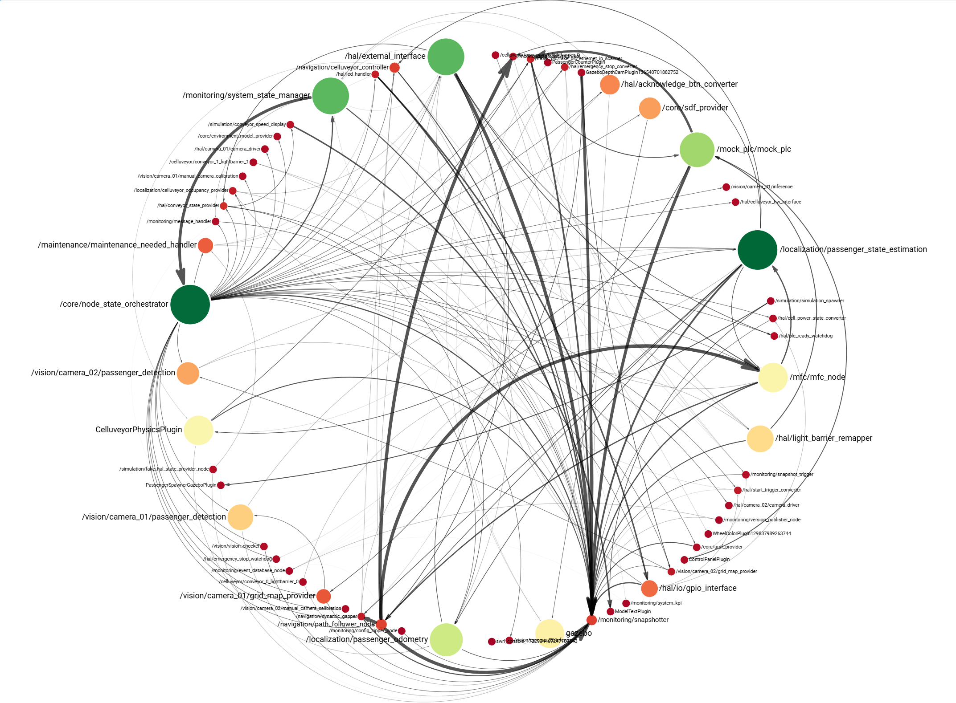
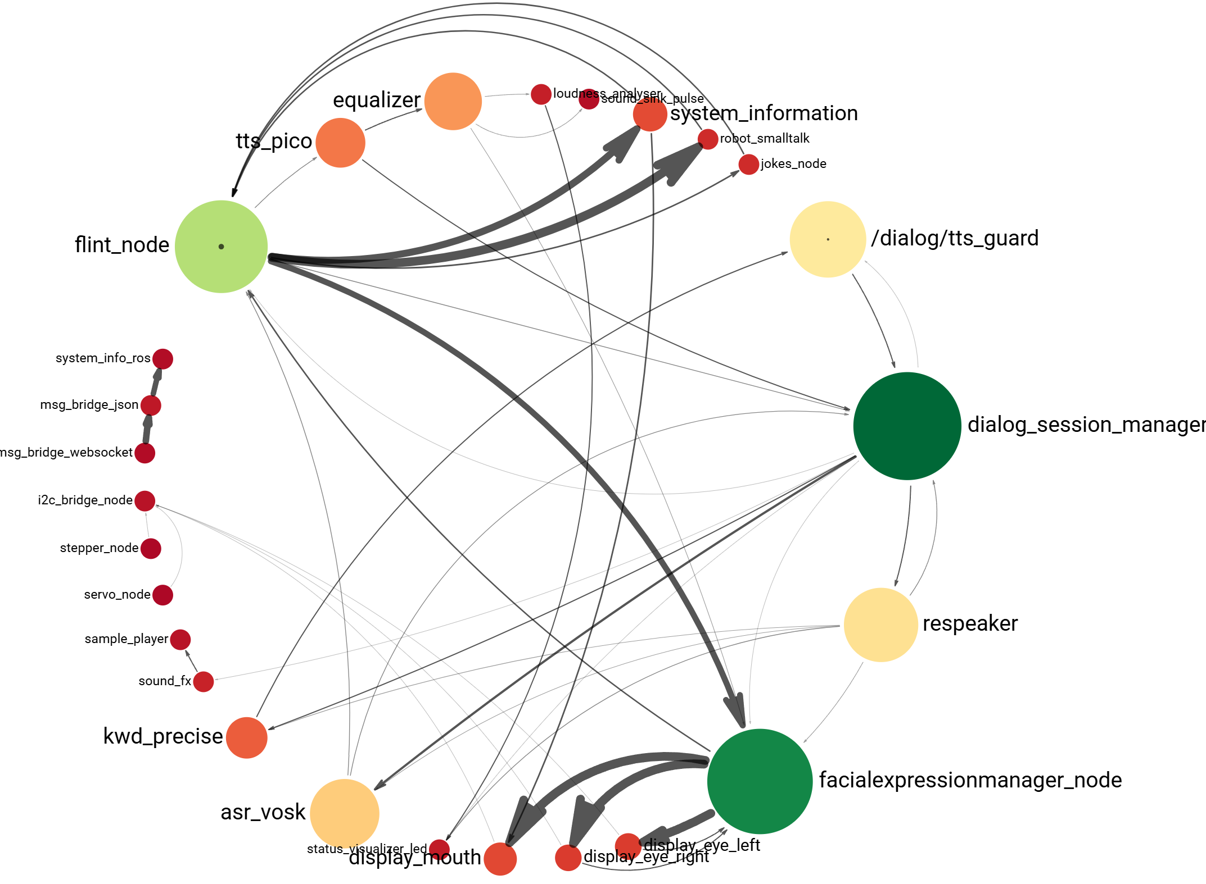
Scalability with Data Aggregation
Syntactic System Analysis
Information Aggregation
Flow Sorting
Node Clustering
Community Detection
6 nodes
Hierarchical Layouting
Focus & Context Visualization
61 nodes
26 nodes

Slide 22
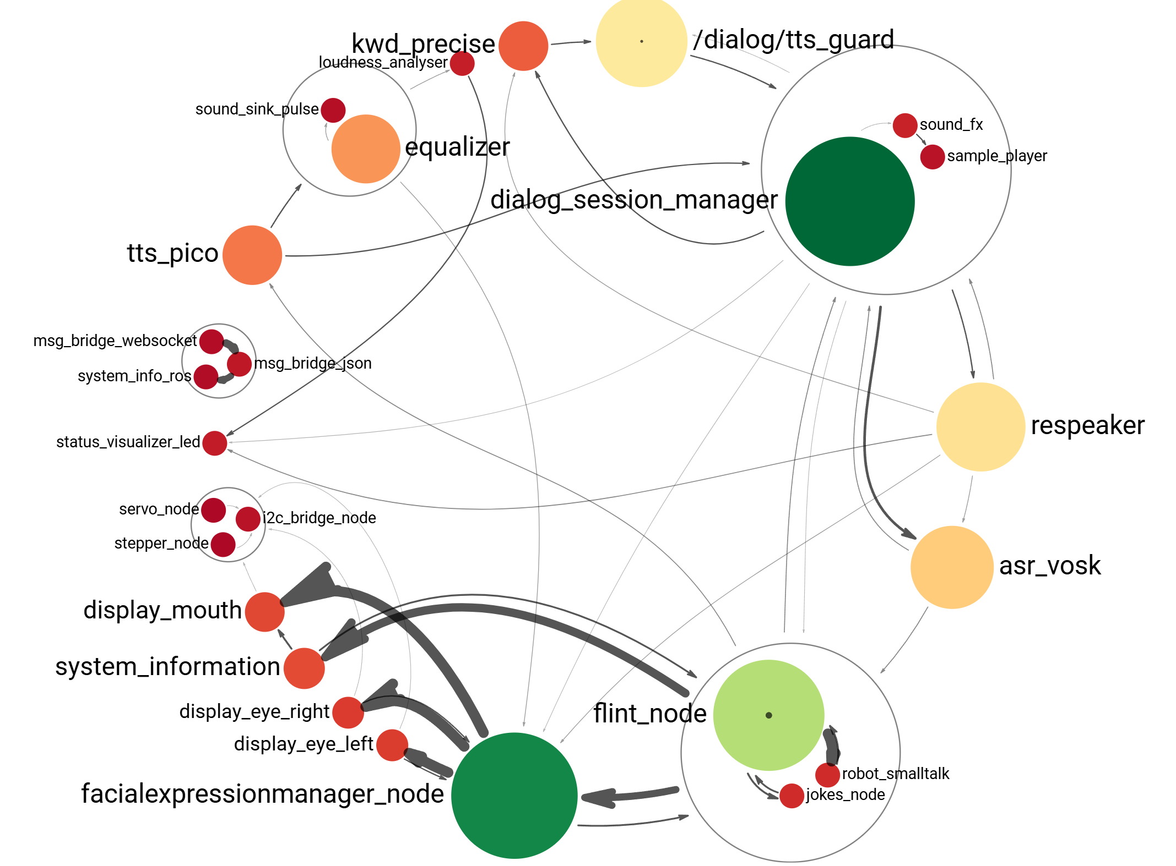
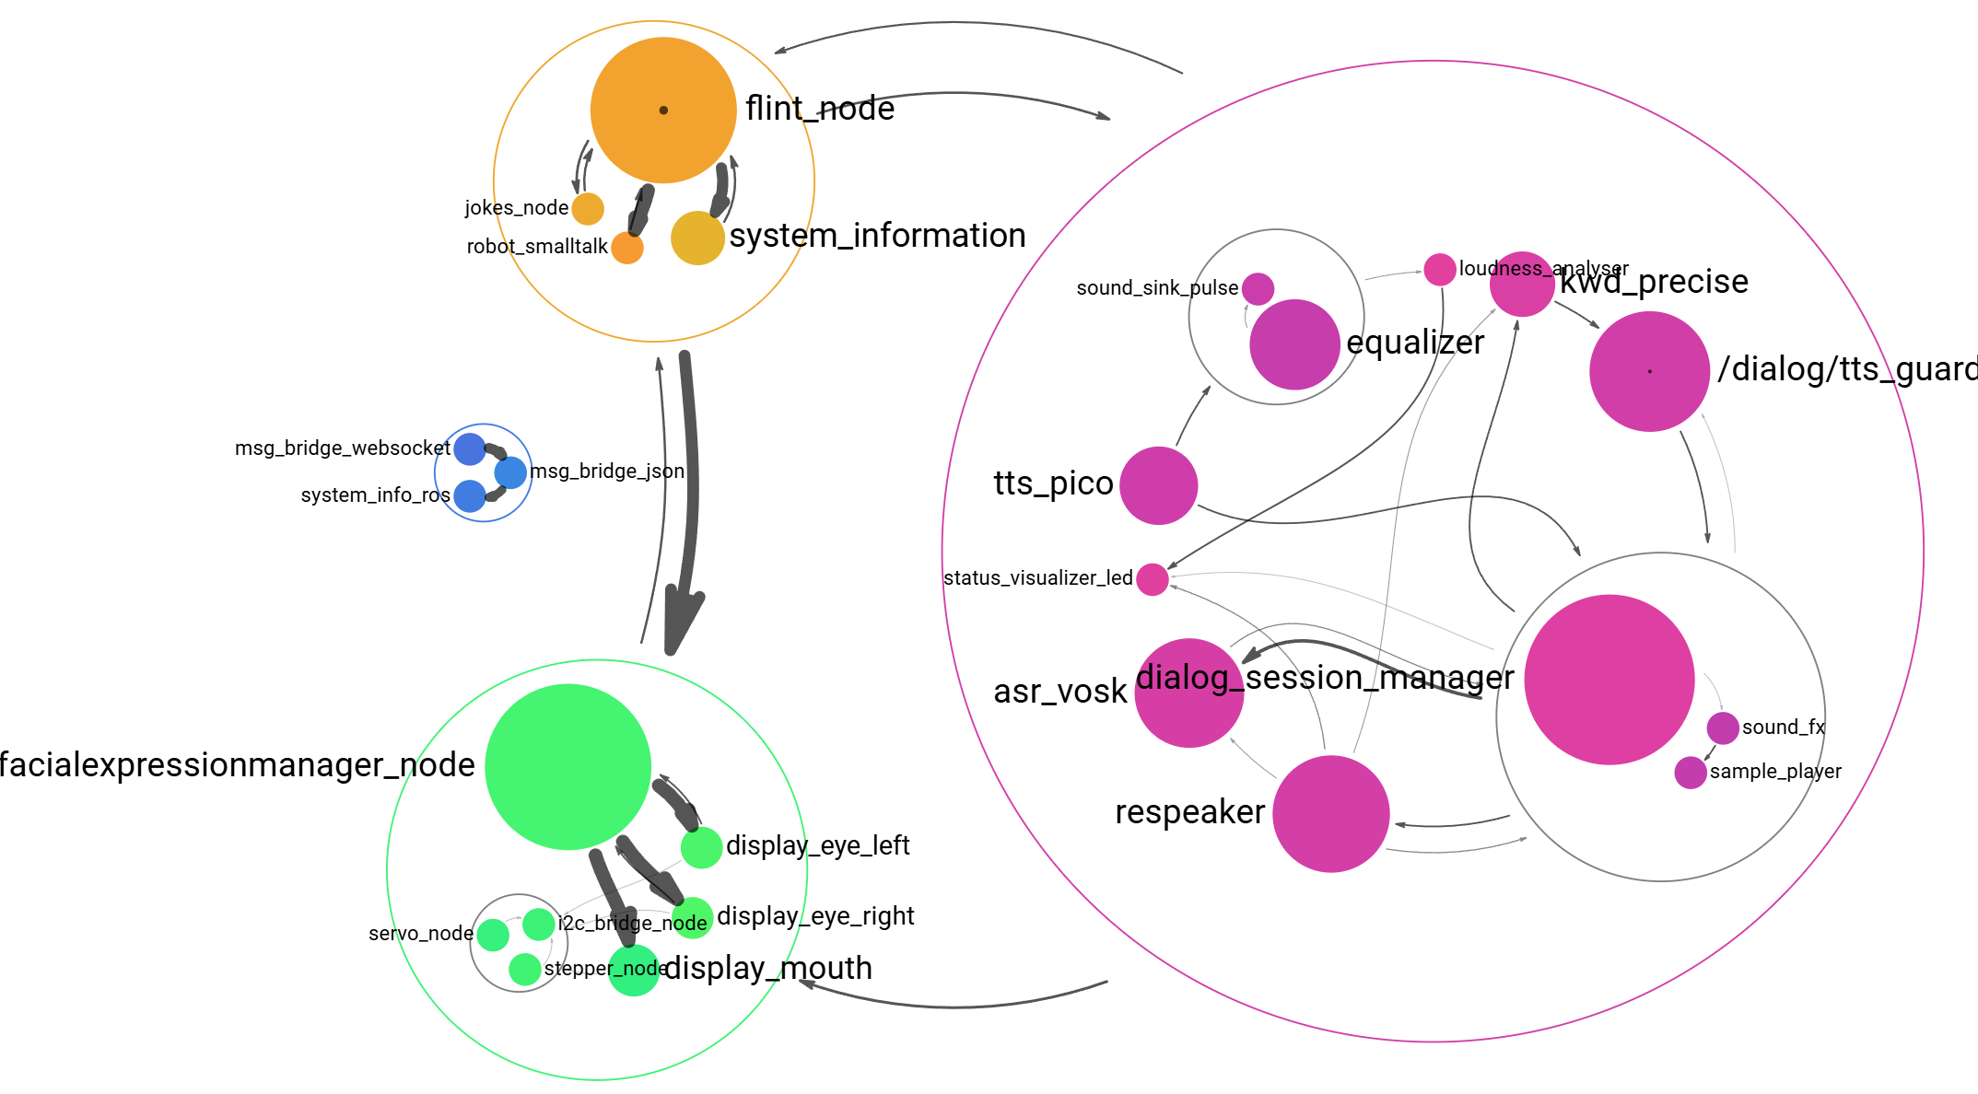
Further Complexity Reduction
Goal: A scalable visualization technique for systems up to ~100 nodes
Syntactic System Analysis
Sub-Tree Extraction
Information Aggregation
Node Aggregation
Flow Sorting
Node Clustering
Community Detection
Hierarchical Layouting
Community Detection
Focus & Context Visualization
Farben Gleich lassen!

Slide 23




Content of the Master’s Thesis
Visualization
Data Collection
Algorithms
Multi-level visualization with different LoDs, aggregated views / data
Detecting the syntactic relevance of
nodes & edges
Collecting data
from available systems
Evaluation
Collecting data
from the community
Sorting of nodes according to dataflows
Comparison of established techniques
Synthesis of data
with similar characteristics
Aggregation of nodes
Collection of quantitative and qualitative metrics
Detection of communities
(Expert Study)

Slide 24
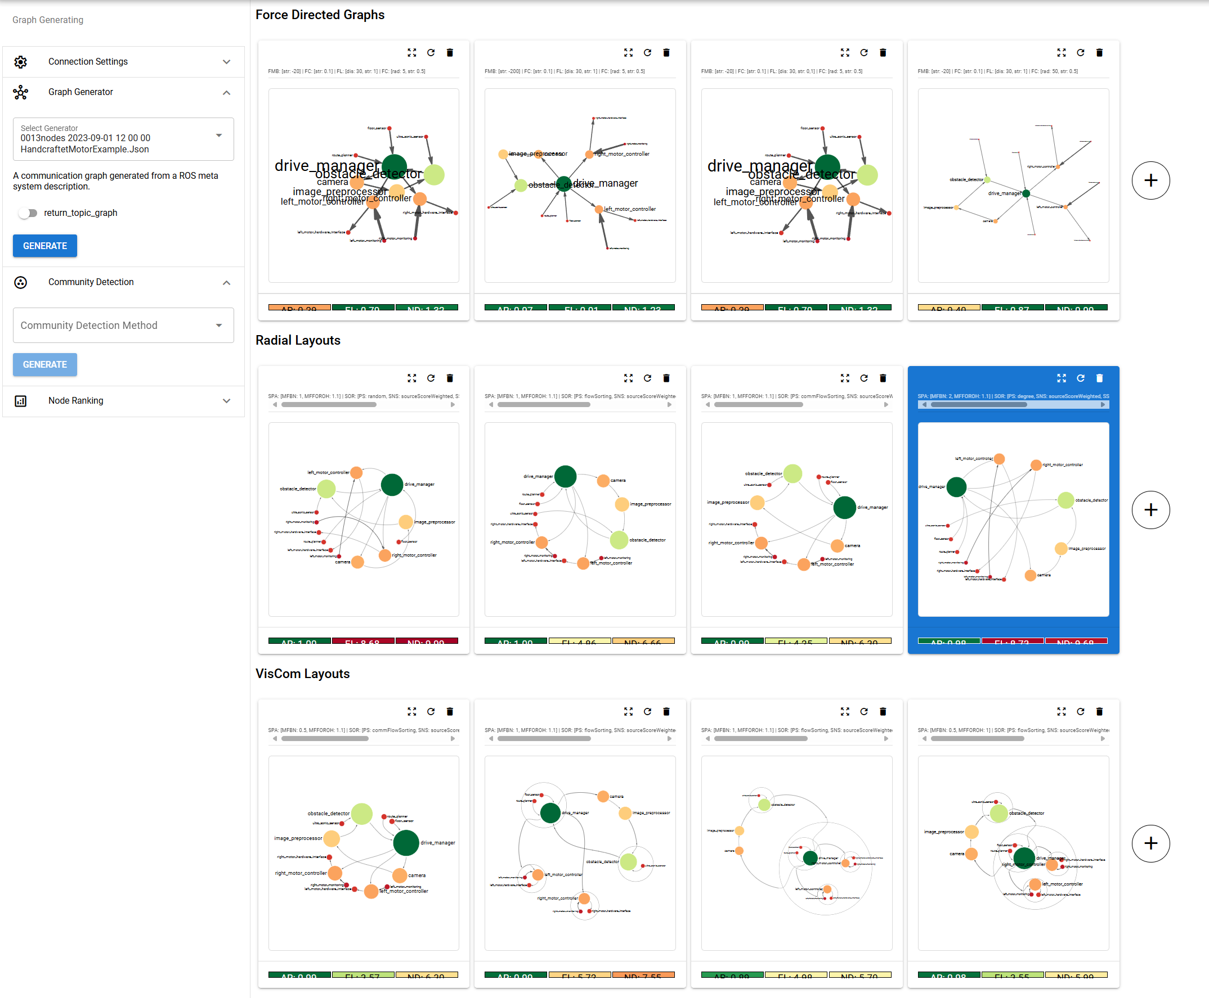
Evaluation
Web-App for Evaluation of
Layout Algorithms
Calculation of quantitative metrics:
Edge Lengths
Node Distances
Edge Crossings
Edge/Node Crossings
Edge Bends
Angular Resolution (between adjacent edges)
Aspect Ratio
Neighborhood Preservation
Node Uniformity
Collection of qualitative metrics
in an expert study:
graph aesthetics
readability (e.g. adjacency comprehension)
traceability of the dataflow
…?

Slide 25
Questions? :-)
Algorithms
Data Collection
Detecting the syntactic relevance of
nodes & edges
Collecting data
from available systems
Sorting of nodes according to dataflows
Collecting data
from the community
Aggregation of nodes
Synthesis of data
with similar characteristics
Detection of communities
Evaluation
Comparison of established techniques
Visualization
Collection of quantitative and qualitative metrics
Multi-level visualization with different LoDs, aggregated views / data

Slide 26
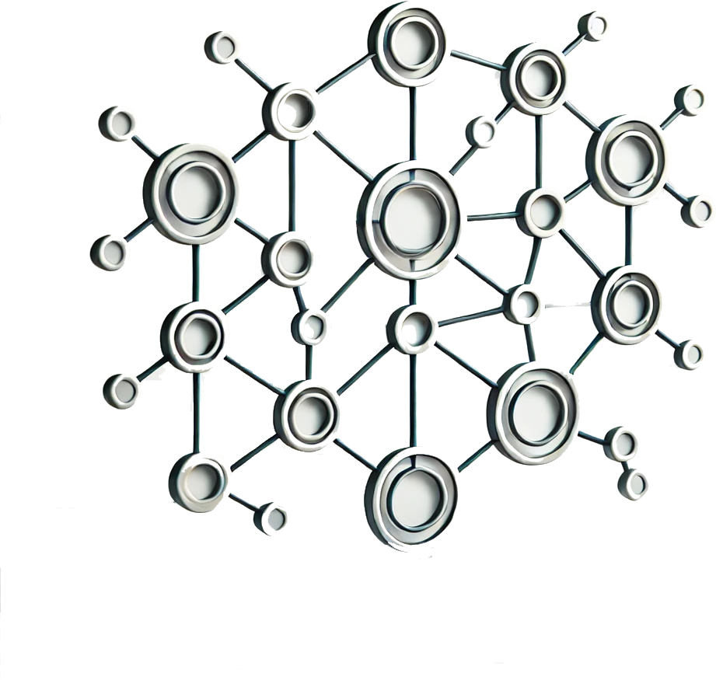

Slide 27
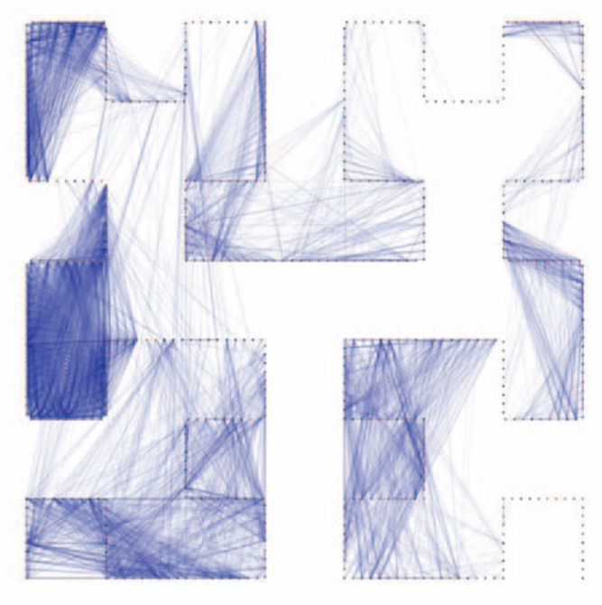
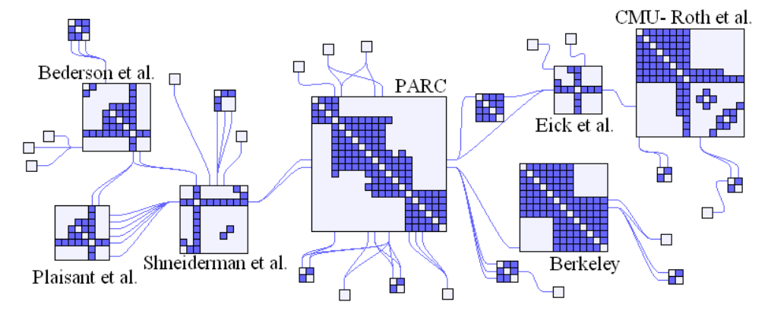
Henry, Fekete, and McGuffin, “NodeTrix.” 2007
Muelder and Kwan-Liu Ma, “Rapid Graph Layout Using Space Filling Curves.” 2008

Slide 28
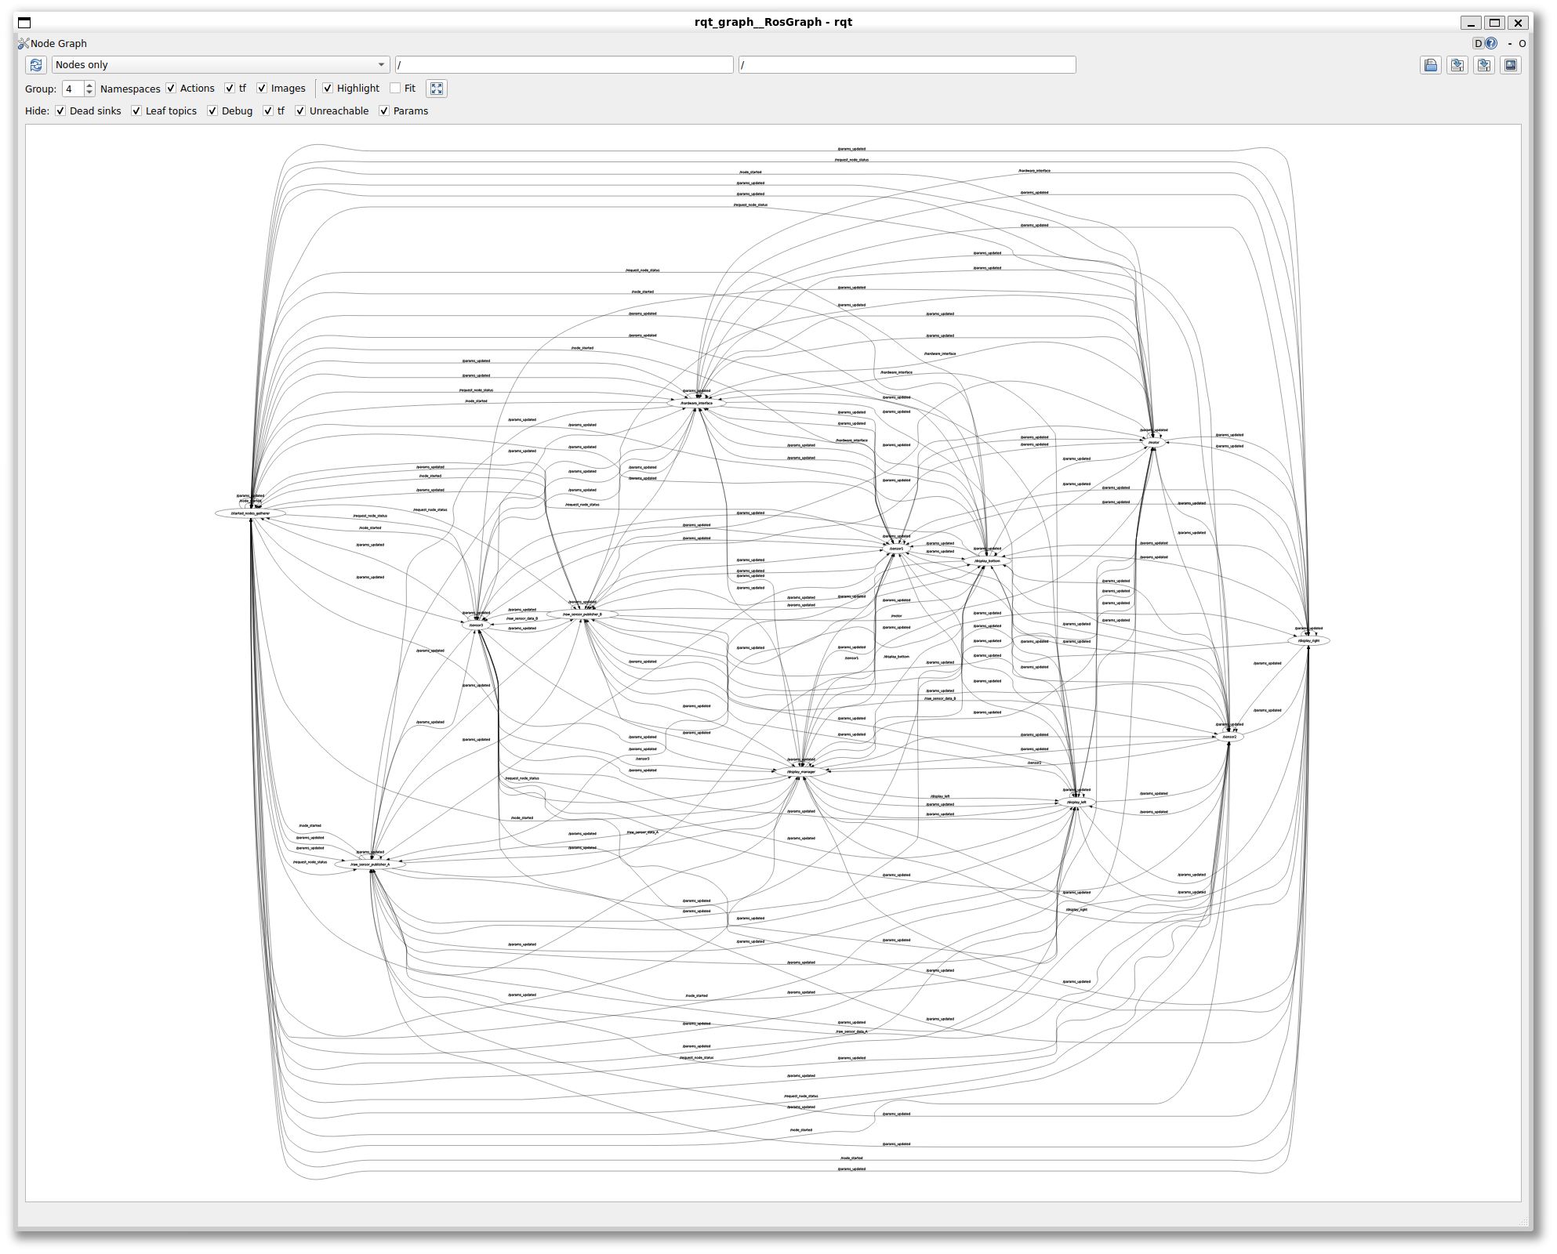
12 Nodes (completely connected)

Slide 29
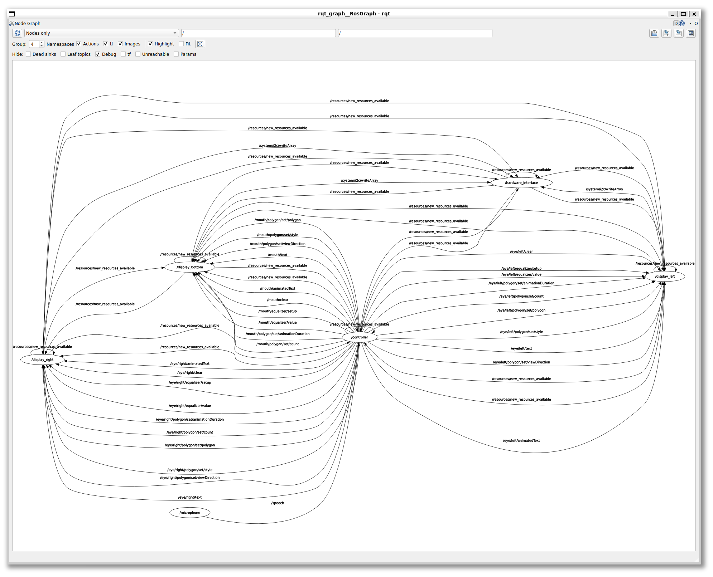

Slide 30
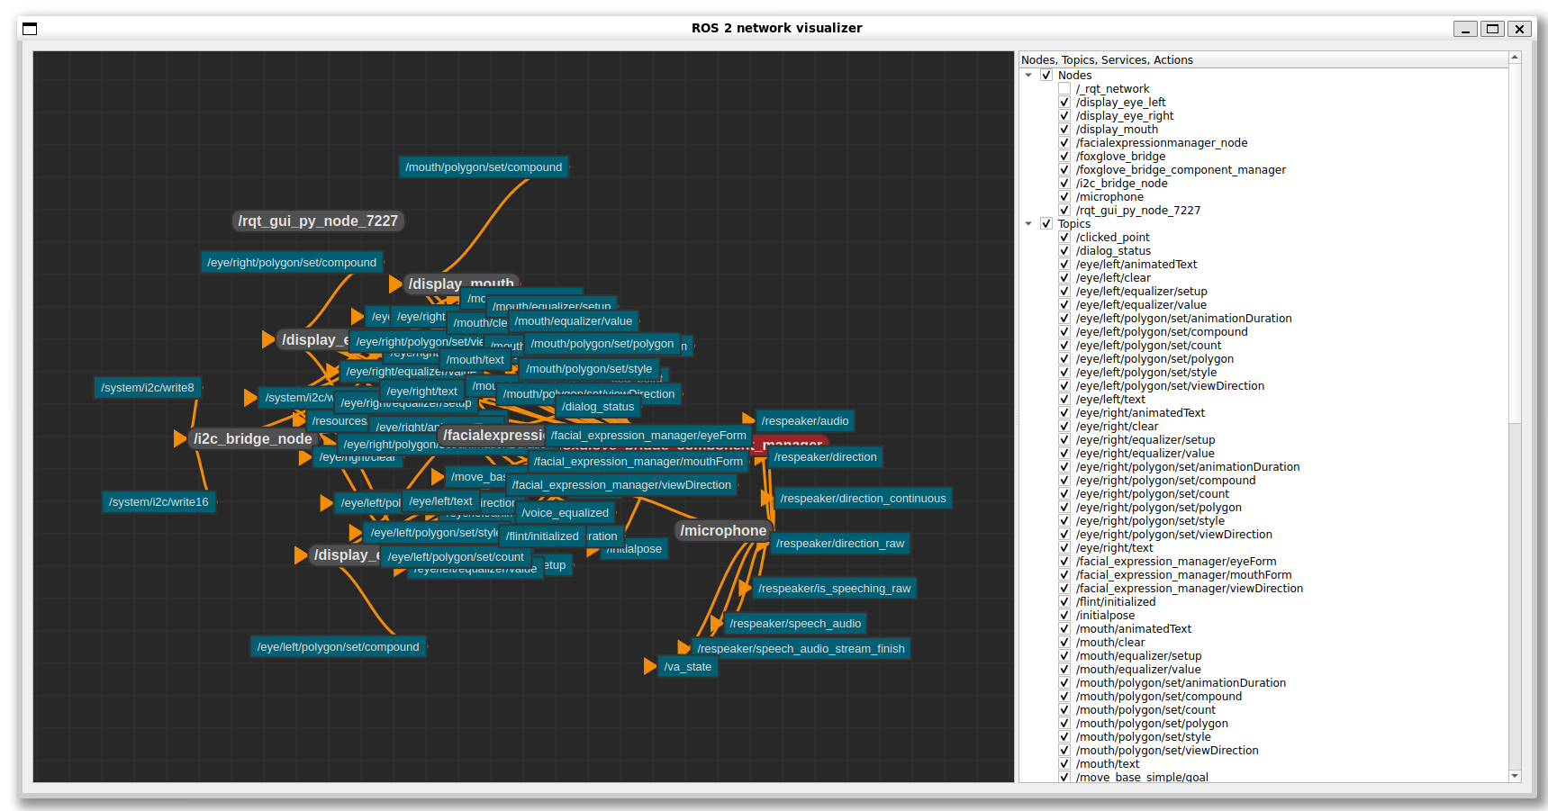

Slide 31
Warum führen bekannte Techniken nicht zum Ziel
Force-Directed Layouts
Hierarchy-Based Layouts
Cluster-Based Layouts

Slide 32
Related Work

Slide 33
State-of-the-Art Tools

Slide 34
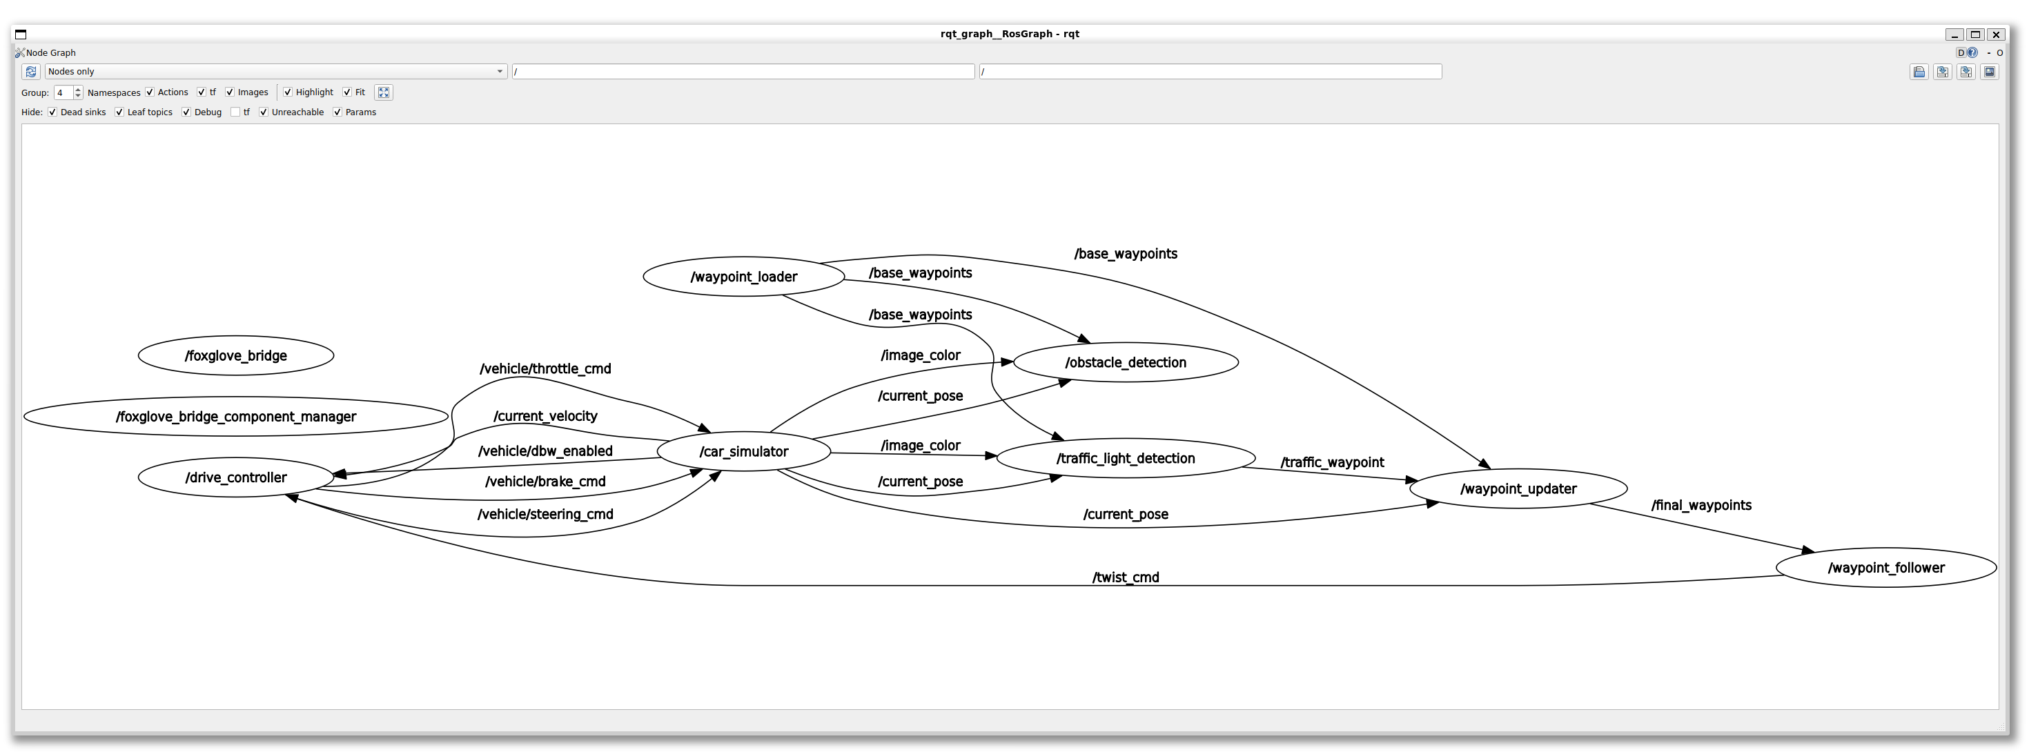
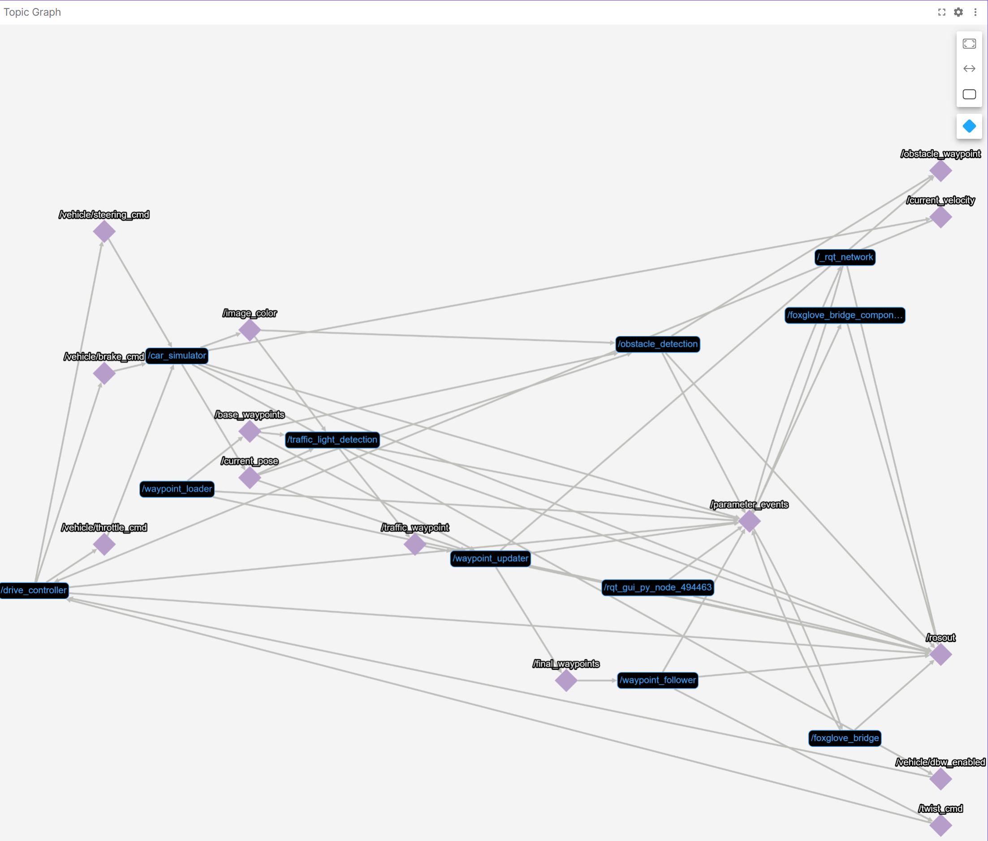
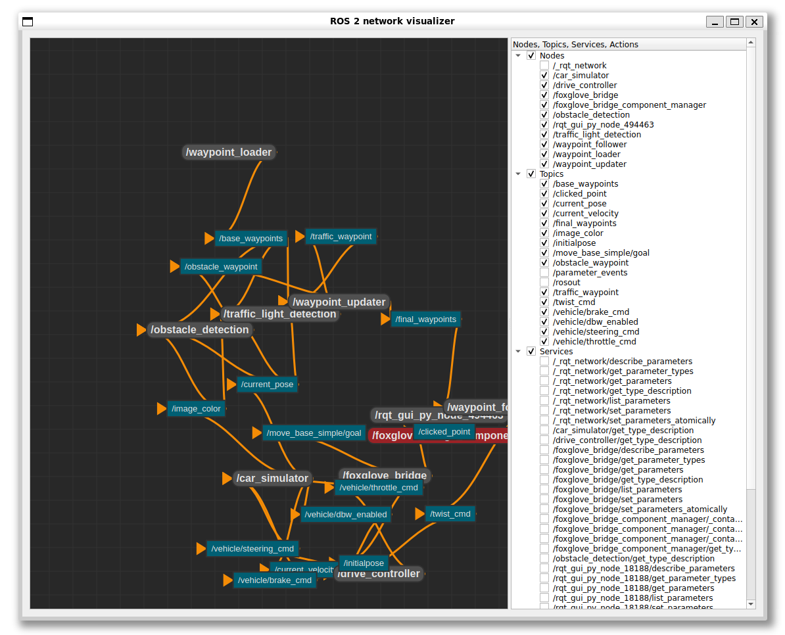
6-node System (few topics)

Slide 35
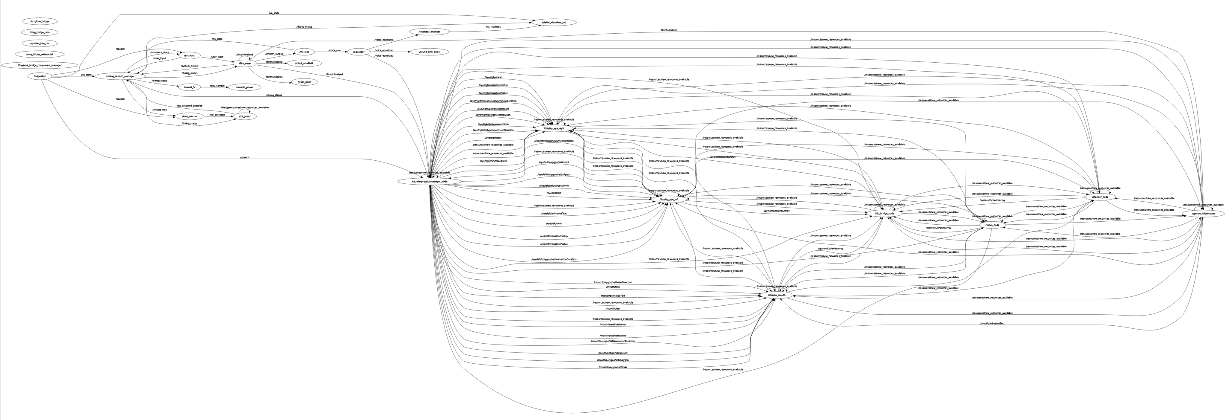
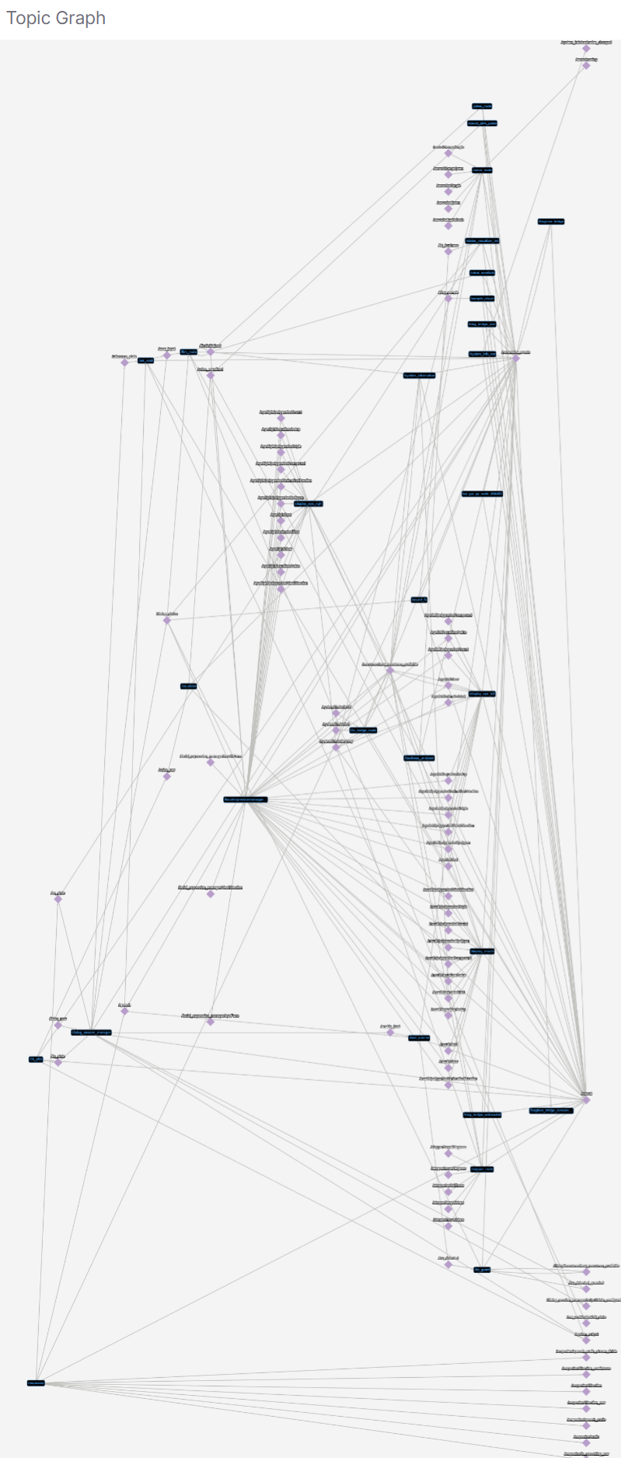
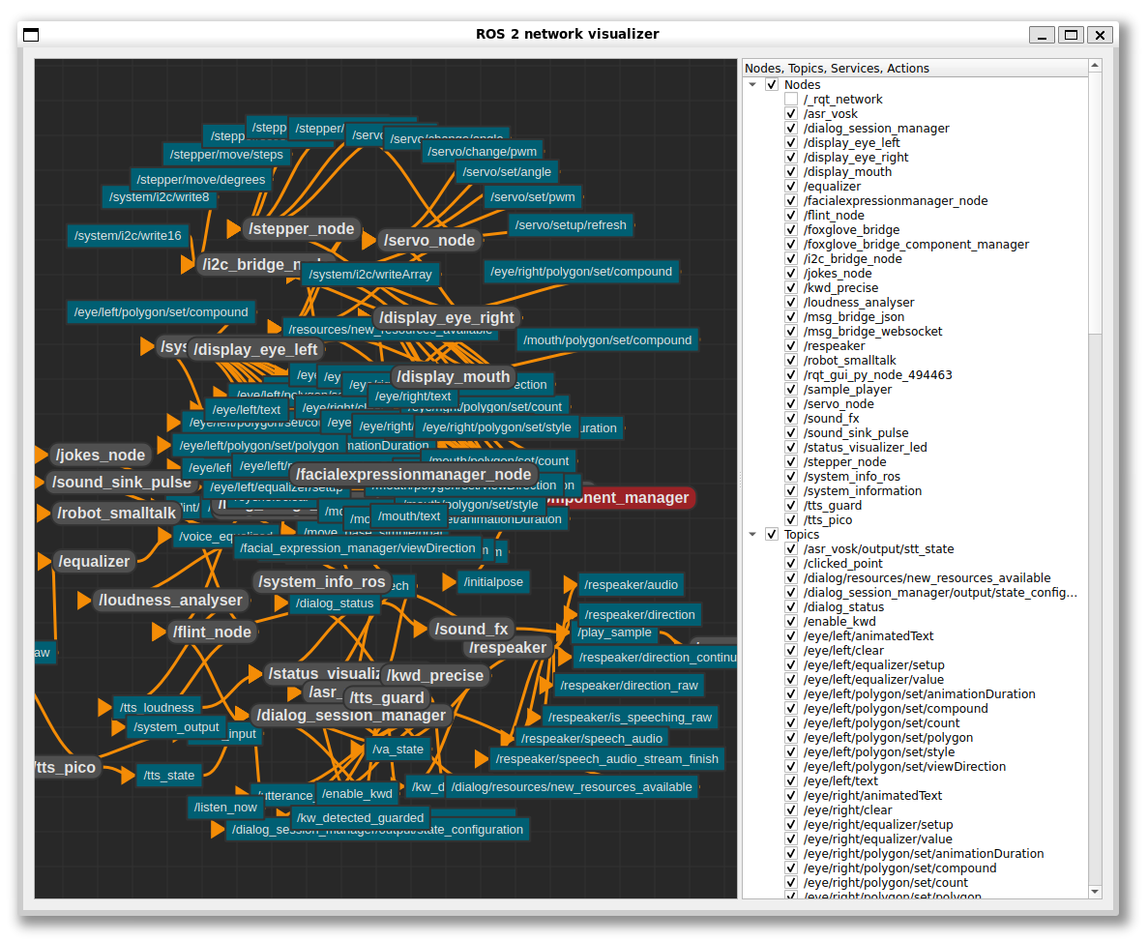
26-node System

Slide 36
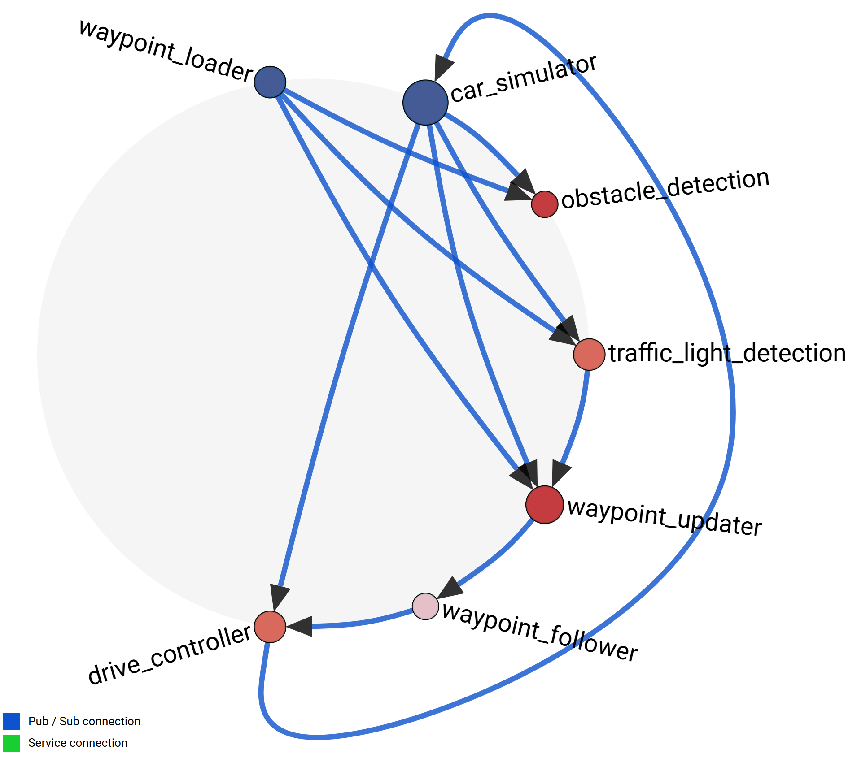
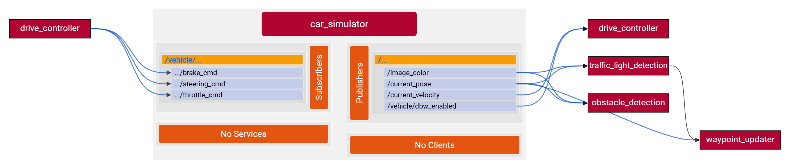
MTVA Prototype

Slide 37
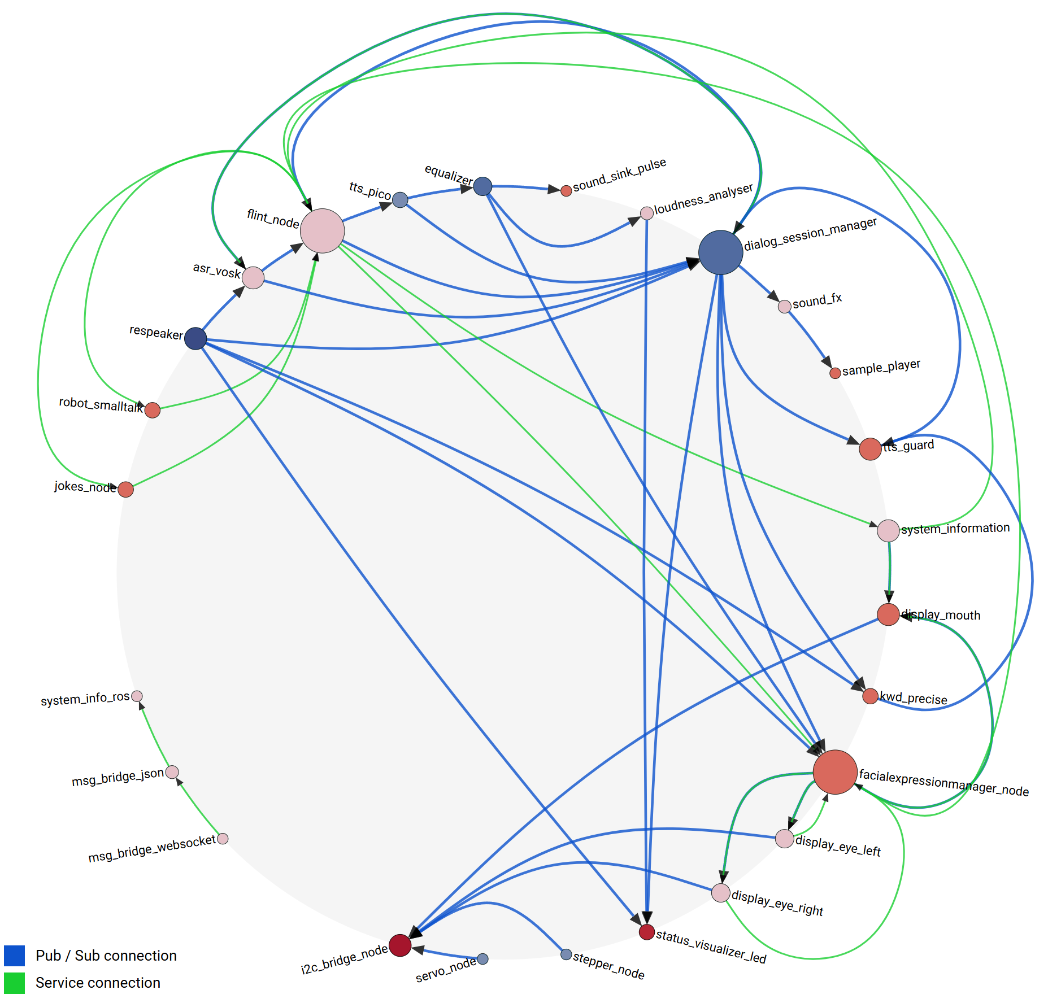
MTVA Prototype

Slide 39
References
Visualizations:
“Rqt_graph - ROS Wiki.” Accessed April 22, 2024. https://wiki.ros.org/rqt_graph.
“Ros2/Ros_network_viz.” Python. 2021. ROS 2, December 1, 2024. https://github.com/ros2/ros_network_viz.

Slide 40
What is ROS?

Slide 41




What is ROS?
package management
hardware abstraction
real time capabilities
Robot Operating System
[Quigley et al. 2009] & [Macenski et al. 2022]
ROS | AWS Robotics Blog (amazon.com)
node-based communication
leading framework for personal and industrial robot development
Isaac Robot Operating System (ROS) | NVIDIA Developer
ROS running on ISS - ROS robotics news

Slide 42
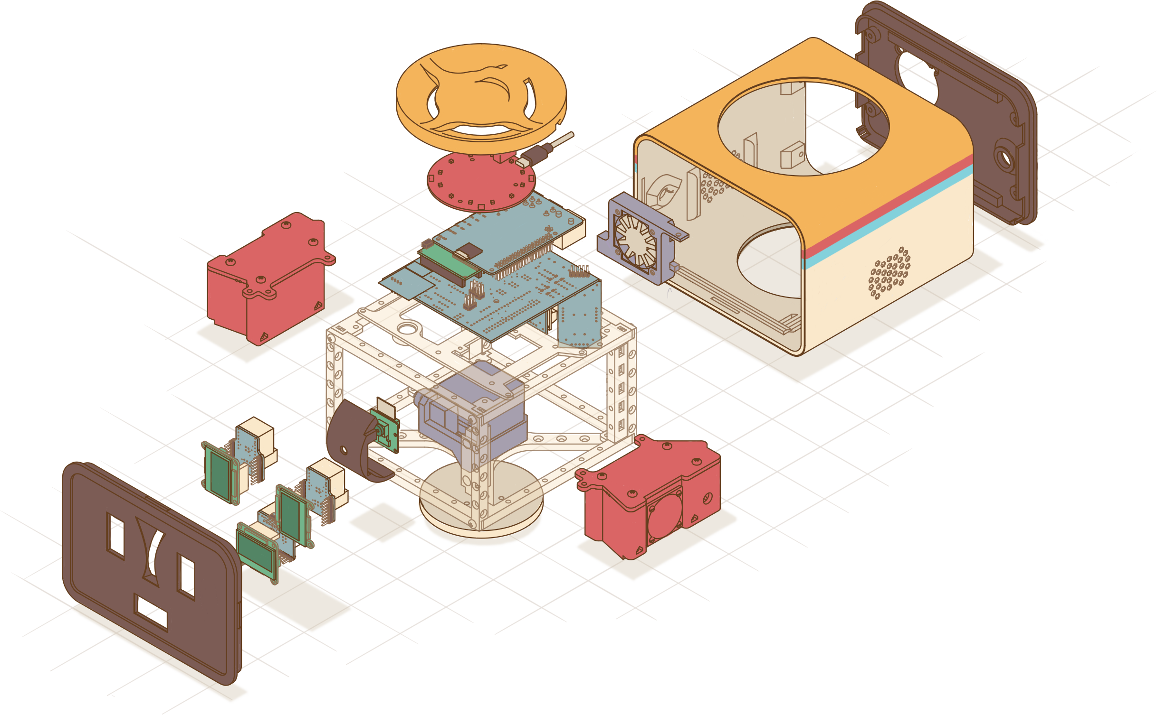
ROS Nodes
Interface Nodes:
I2C Interface
UART Interface
SPI Interface
Internal Nodes:
Resource Manager
Facial Expression Manager
Sound Tracking Controller
Face Recognition
SmartHome Control Interface
Sensor Nodes:
Microphone Array
Camera
Temperature
Actor Nodes:
Fan Control
Camera Motor
Stand Motor
Left Eye Display
Right Eye Display
Mouth Display
Speaker
LED Visualization
Speech Pipeline Nodes:
Keyword Detection
Speech To Text
Text To Speech
Natural Language Understanding
Sound Effects
Dialog Session Manager
Loudness Analyzer
Smalltalk
Jokes

Slide 43
ROS Node Communication
Publisher / Subscriber Communication
Call-and-response Communication
Message Topic
Node
/service
Node
Request
/topic
Node
Node
Node
Response
Publisher-Node
Subscriber-Nodes
Client-Node
Service Name
Server-Node
Node
/topic
Node
Node
Node
/service
Node
Node
Node
Node
Node
Node
single Server
/topic
Node
Node
multiple Clients
Node

Slide 44
Goal of the Project

Slide 45

What We Want to Visualize
Project Goal: Interactive visualization to support development process
Overview
Details
Developer wants to see…
… which nodes exist in the system!
… which topics are offered by a node!
… how the nodes are connected!
… incoming and outgoing connections of a selected node!
… which nodes are central / important / strongly connected!
… connection details:
message types, etc.

Slide 46
Scope of the Project
What the project should do?
What the project should not do?
Abstract visualization of a current system snapshot based on system introspection
Visualize concrete live data published by a node (like Data-Charts, Images, Audio Data, Point Clouds, etc.)
→ support development process at a higher level
Allow live manipulation of the system (e.g., changing the connections between nodes)

Slide 47
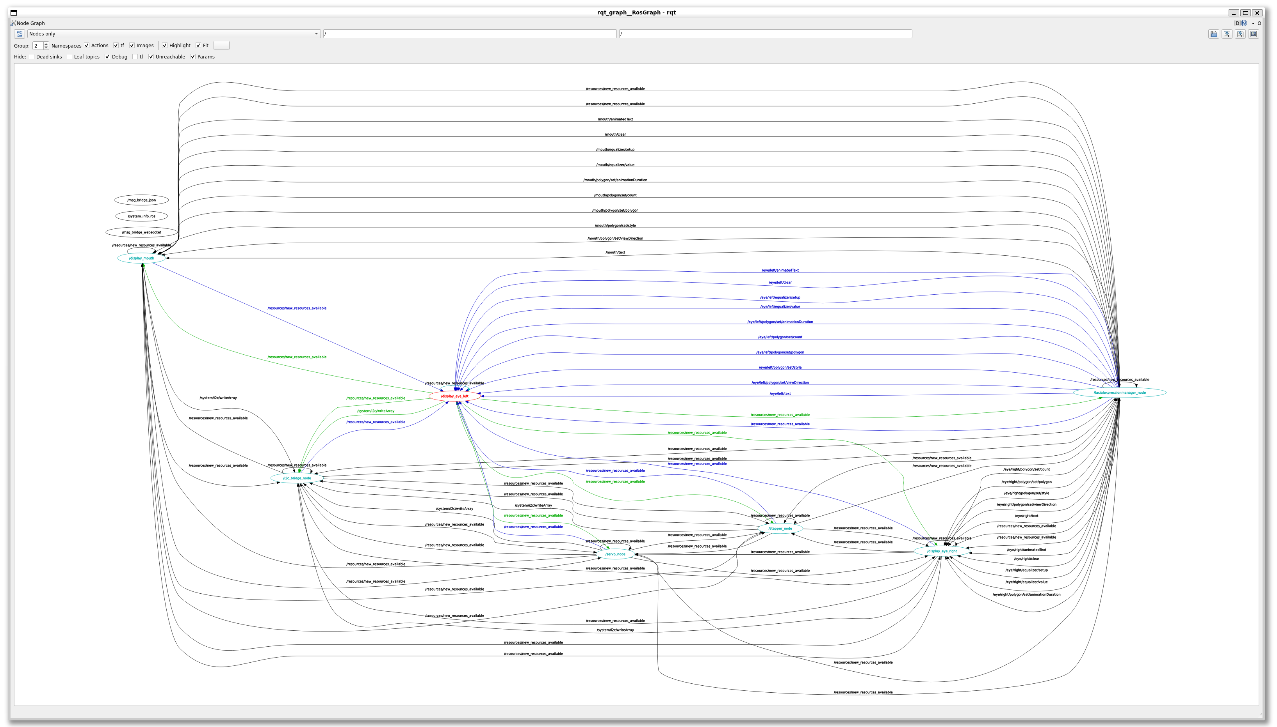
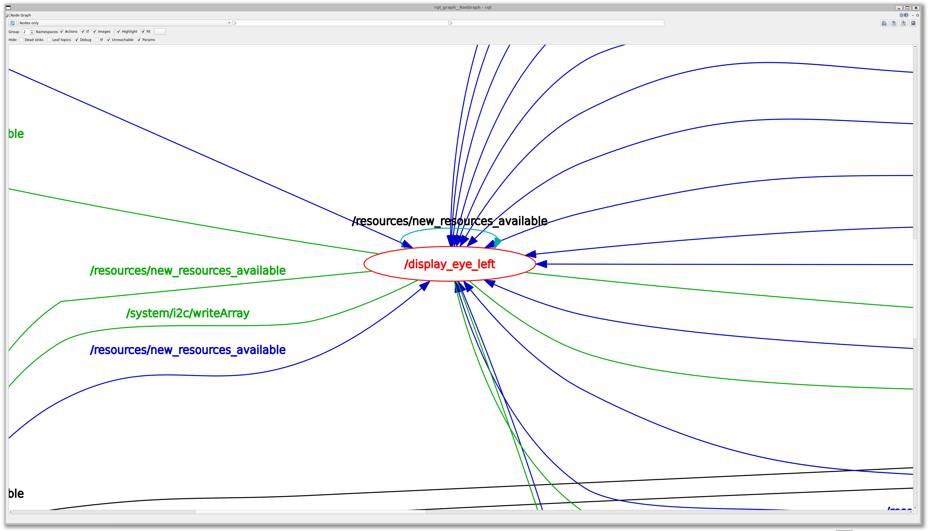
State of the Art
Project ‘rqt_graph’
ros-visualization/rqt_graph (github.com)

Slide 48
rqt_graph
Node-only view of 10 nodes

Slide 49
rqt_graph
Node-only view of 10 nodes
Shows nodes, incoming and outgoing connections

Slide 50
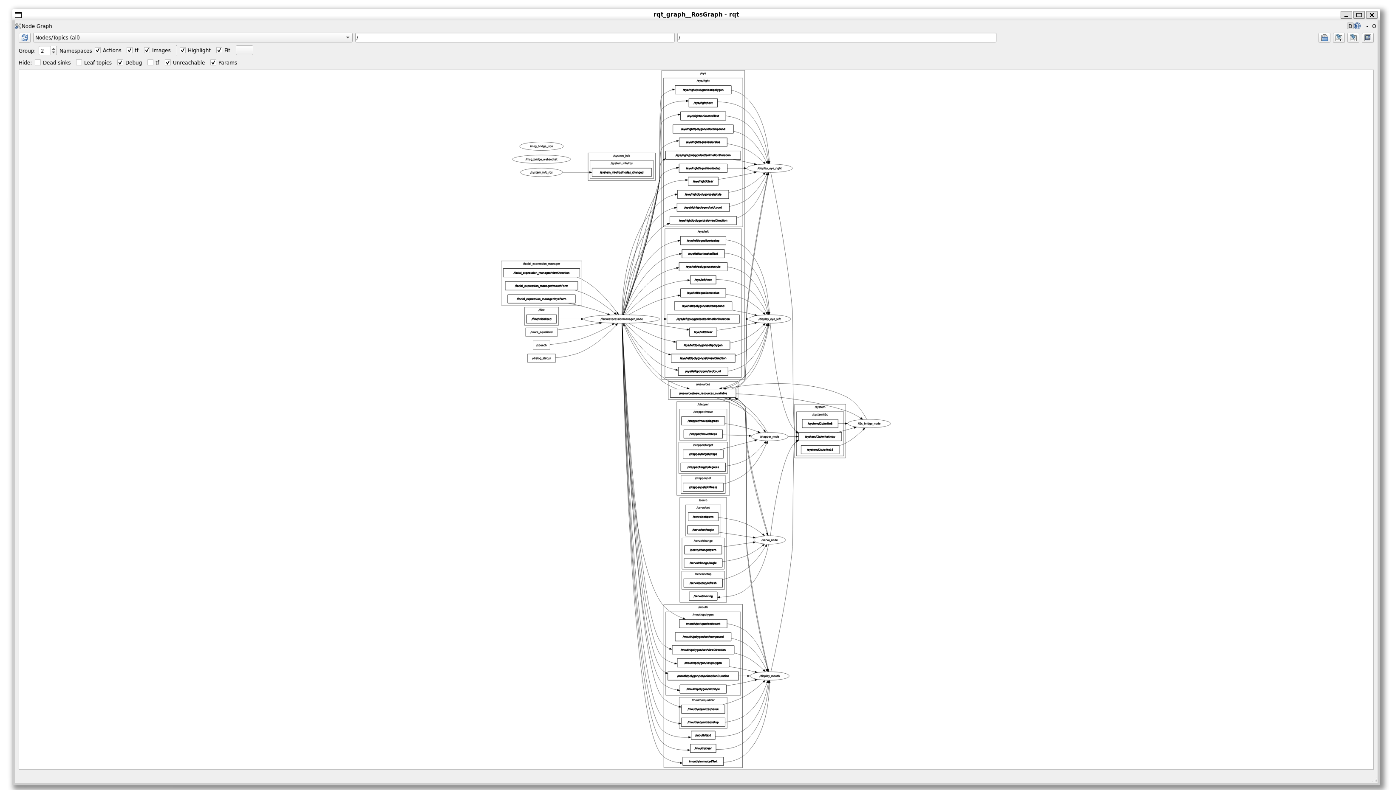

rqt_graph
Node/Topics view of 10 nodes

Slide 51
rqt_graph
Node/Topics view of 10 nodes
Shows nodes and their topics

Slide 52


Problems of rqt_graph
visual cluttering
the only interactions:
hover, zoom, pan
requires a ROS Desktop environment
manual refreshing

Slide 53
Other ROS Visualizations?

Slide 54





Other Visualizations and Related work
Ivanov, Artem, et al. "Online monitoring and visualization with ros and reactjs." 2021 International Siberian Conference on Control and Communications (SIBCON). IEEE, 2021.
Bédard, Christophe, et al. "Message flow analysis with complex causal links for distributed ROS 2 systems." Robotics and Autonomous Systems 161 (2023): 104361.
Zea, Antonio, and Uwe D. Hanebeck. "iviz: A ROS visualization app for mobile devices." Software Impacts 8 (2021): 100057.
Setting up a robot simulation (Basic) — ROS 2 Documentation: Foxy documentation
Visualizing ROS 2 data with Foxglove Studio — ROS 2 Documentation: Foxy documentation

Slide 55
Why Not Just Expanding rqt_graph?

Slide 56
Architecture in rqt_graph
Desktop Server System (Linux, etc.)
ROS-Environment
Meta-info about the current nodes in the system
rqt_graph
User Access
ROS-Nodes
Arbitrary nodes in the system
Qt-App and ROS-Node

Slide 57
Architecture in rqt_graph
Desktop Server System (Linux, etc.)
ROS-Environment
rqt_graph
User Access
ROS-Nodes
Qt-App and ROS-Node
rqt_graph is simultaneously…
… a ROS Node
and
… a qt5 application
You need simultaneously …
… a ROS Environment
and
… a Desktop Environment

Slide 58

Goal of the New Approach
rqt_graph needs simultaneously…
… a ROS Environment
and
… a Desktop Environment
We want to have independently:
… a ROS Environment
and
… any device to visualize the ROS Environment

Slide 59

Architecture of the New Approach

Slide 60
Architecture in rqt_graph
Desktop Server System (Linux, etc.)
ROS-Environment
Meta-info about the current nodes in the system
rqt_graph
User Access
ROS-Nodes
Arbitrary nodes in the system
Qt-App and ROS-Node simultaneously
== ROS-Nodes (Python/C++)

Slide 61

New System Architecture
Desktop Server System (Linux, etc.)
ROS-Environment
Meta-info about the current nodes in the system
provided Services
Request ROS data via WebSockets
SystemInfo Node
/get_all_node_names
ROS-Bridge Server
WebApp for Visualization
User Access
ROS-Nodes
/get_publisher_by_node
/get_subscriber_by_node
…
Arbitrary nodes in the system
ROS-Node dedicated to provide meta-info
Generic
ROS-to-WebSocket Bridge
== ROS-Nodes (Python/C++)
== Web-App (Node.js + TypeScript)
== Developed during the project

Slide 62






Technical Details
ROS-System
Visualization WebApp
Platform
Ubuntu 22.04
Platform
theoretically any web browser platform
Framework
ROS2 Humble (current LTS)
Framework
Node.js
Vue.js
D3.js
Quasar (CSS-Framework)
Languages
Python for custom ROS-Nodes
Languages
TypeScript
SystemInfo Node
ROS Intrinsics
ROS-Bridge Server
Python Websockets
Libraries
TypeScript Reimplementation of RobotWebTools/roslibjs: The Standard ROS JavaScript Library (github.com)
Python reimplementation of RobotWebTools/rosbridge_suite: Server Implementations of the rosbridge v2 Protocol (github.com)
Notes:
theoretisch jede Plattform, da nur offene und standardisierte Web-Technologien eingesetzt werden

Slide 63










Restrictions With the Architecture
WebApp enables use on theoretically any platform
SVG Rendering may depend on specific browser
Chromium-based
… needed some workarounds for SVG-Text-Rendering

Slide 64

The Visualization

Slide 65
Visualization of the Overview
Nodes
Overview
… which nodes exist in the system!
… how the nodes are connected!
Connections
… which nodes are central / important / strongly connected!

Slide 66



Characteristics of the ROS Nodes
Different types of nodes?
In terms of semantics?
Nodes for sensor input, actor output, image processing, internal management, etc…
Yes
In terms of syntax?
Nodes as collections
of connections
No
No different types of nodes!
This project: Visualization based on system introspection
No hierarchies!

Slide 67
Characteristics of the Node Connections

Slide 68
Publisher / Subscriber Connections
Publisher / Subscriber communication
Message Topic
Node
Node
/topic
Node
Publisher-Node
Subscriber-Nodes
Example:
Microphone
Recorder
/audio
Dataflow
Publisher / Subscriber communication determines a data flow direction!
always?

Slide 69
Broadcast Connections
Example:
Microphone
Recorder
/new_node_created
Manager
simultaneous publisher & subscriber on the same topic
Use Cases:
- internal parameters
Dataflow in both directions
„Broadcast Connections“
= self-defined idiom
- resource management
- etc…

Slide 70
Client / Server Connections
Call-and-response Communication
/service
Request
Node
Node
Response
Client-Node
Service Name
Server-Node
Example:
Microphone
/audio
Dataflow?
Recorder
/start_recording
Manager

Slide 71
Client / Server Connections
Microphone
/audio
Use cases for Client / Server communication
Recorder
/start_recording
Trigger action
Manager
Get data
/recording_status
Send data
Manager
/set_volume
Manager
No clear dataflow without semantics

Slide 72


Characteristics of Connections
Pub / Sub connections
Broadcast connections
Service connections
Strictly define a data flow direction
Nodes are interchangeable
Unknown dataflow direction

Slide 73

Let’s Get an Overview

Slide 74


Example System: Nodes
ROS-Node
any connection between nodes
Publisher / Subscriber connection
Client / Service connection

Slide 75

Example System: All Connections
ROS-Node
any connection between nodes
Publisher / Subscriber connection
Client / Service connection
Sort of
Force-Directed-Graph
→ not suitable for good overview

Slide 76

Example System: Pub / Sub Connections
ROS-Node
any connection between nodes
Publisher / Subscriber connection
Client / Service connection

Slide 77

Example System: Service Connections
ROS-Node
any connection between nodes
Publisher / Subscriber connection
Client / Service connection

Slide 78

Approaches to Handle Connections
The goal:
Bringing some structure into that node set!

Slide 79
Approaches to Handle Connections
Pub / Sub connections
Broadcast connections
Service connections
Strictly define a data flow direction
Nodes are interchangeable
Unknown dataflow direction
1. Ignore Services
Main criterion for the structure!
Ignore Broadcast completely
Approach
or
2. Define clients as outgoing, servers as ingoing (assumption)

Slide 80

Get Topological Generations

Slide 81

What are Topological Generations?
“A topological generation is node collection in which ancestors of a node in each generation are guaranteed to be in a previous generation, and any descendants of a node are guaranteed to be in a following generation. Nodes are guaranteed to be in the earliest possible generation that they can belong to.” NetworkX Documentation

Slide 82

What are Topological Generations?
“A topological generation is node collection in which ancestors of a node in each generation are guaranteed to be in a previous generation, and any descendants of a node are guaranteed to be in a following generation. Nodes are guaranteed to be in the earliest possible generation that they can belong to.” NetworkX Documentation
Only works for DAGs (Directed Acyclic Graphs)

Slide 83

Topological Generations in Non-DAGs?
what if we have a cycle?
(common in ROS)

Slide 84



Topological Generations in Non-DAGs?
Topological generations become ambiguous

Slide 85

Selecting a Start Node

Slide 86


Calculating a „Source-Score“ of a Node
Heuristics:
The higher the score of a node
→ the more a node is a source of data
→ the earlier the generation of a node should be
(while still retaining the properties of topological generations)

Slide 87

Source Scores in our Example

Slide 88

Algorithm to Retrieve Topological Generations
Simplified algorithm to calculate the generations:
While there are unassigned nodes:
select start node := unassigned node with highest score
add all successors, considering only forward connections
ignore connections that create circles

Slide 89


Algorithm to Retrieve Topological Generations
Result depends on Source-Score-Heuristics

Slide 90

Algorithm to Retrieve Topological Generations
Result depends on Source-Score-Heuristics

Slide 91
Placement of the Nodes

Slide 92

How to Place the Nodes
Placement according to Topological Generations is nice for simple graphs, but
not scalable at all

Slide 93

How to Place the Nodes
→ a lot of methods for DAGs linearize the arrangement of nodes
→ transfer from topological generations to topological sorting
DAG Drawings with the Sugiyama-Method according to:
Sugiyama, Kozo, Shojiro Tagawa, and Mitsuhiko Toda. "Methods for visual understanding of hierarchical system structures." IEEE Transactions on Systems, Man, and Cybernetics 11.2 (1981).

Slide 94


How to Place the Nodes
→ transfer from topological generations to topological sorting

Slide 95



Problems with Plain Topological Linearization
Problem 1:
inefficient display utilization
Problem 2:
order of linearizing the generations is not neglectable for a good visualization!

Slide 96

Circular Placement
Efficient Display Utilization

Slide 97

Circular Placement

Slide 98

Circular Placement
Screenshot from the App

Slide 99
Flow Sorting
Sort nodes to minimize distances and edge crossing

Slide 100

Flow Sorting
Linearization of topological generations does not consider neighborhood of nodes…
Linearized topological generations
Solution: Flow Sorting
==
Modified depth search try to minimize node distances and edge crossing

Slide 101

Flow Sorting
Linearization of topological generations does not consider neighborhood of nodes…
Flow sorted nodes
Solution: Flow Sorting
==
Modified depth search try to minimize node distances and edge crossing

Slide 102


The Overview

Slide 103
The Overview
Overview
Details
Developer wants to see…
… which nodes exist in the system!
… which topics are offered by an node!
… how the nodes are connected!
… incoming and outgoing connections of a selected node!
… which nodes are central / important / strongly connected!
… connection details:
message types, etc.

Slide 104
The Overview
Overview
Details
… which nodes exist in the system!
… which topics are offered by an node!
… how the nodes are connected!
… incoming and outgoing connections of a selected node!
… which nodes are central / important / strongly connected!
… connection details:
message types, etc.
Following design principles of graph visualization summarized in:
Bennett, Chris, et al. "The aesthetics of graph visualization." CAe. 2007.

Slide 105
The Overview
Following design principles of graph visualization summarized in:
Bennett, Chris, et al. "The aesthetics of graph visualization." CAe. 2007.
Node Placement Heuristics:
Clustering of related nodes → clustering of connected nodes inside a connected component
Even distribution
minimum distance between nodes
number of different distant levels should be minimized → wew only 2 different levels: distance between different connected components & distance between nodes inside a connected component
No overlap of nodes (unless nested) → we have no nesting, nodes are evenly distributed without overlapping
Edge Heuristics:
Minimize number of edge crossings → done by flow sorting
Minimize number of edge bends / Keeping edge bends uniform → circular placement allows homogeneous edge bending, we don’t have to go around obstacles
Minimize max. edge length → done by circular placement
Placing edges at even angles around the node → not strictly done, but implicitly done by different positions of nodes on the circle
Graph Heuristics:
Minimizing total graph area → done by circle
Aspect ration should match container → 16:9 done by UI with circle as center
Flow Heuristics:
Maintain overall flow direction:
Inside the circle → clockwise flow
Outside the circle → counterclockwise flow

Slide 106

The Overview
Overview
Details
Developer wants to see…
… which nodes exist in the system!
… which topics are offered by an node!
… how the nodes are connected!
… incoming and outgoing connections of a selected node!
… which nodes are central / important / strongly connected!
… connection details:
message types, etc.

Slide 107

How to See Details?
… which topics are offered by an node!
… incoming and outgoing connections of a selected node!
… connection details:
message types, etc.

Slide 108

Details of ROS-Nodes
Displaying all details at once floods the screen
Solution:
Detail-View only for a selected central node

Slide 109

Details of ROS-Nodes
Selected node
Nodes with connections TO the selected node
Nodes with connections FROM the selected node
Topics of the selected node

Slide 110

Details of ROS-Nodes
Selected node
Nodes with connections FROM the selected node
2nd selected node
Topics of the selected node

Slide 111


Further Details of ROS-Topics

Slide 112

Live Demo

Slide 113
Conclusions

Slide 114

Conclusions: What we want to visualize
Overview
Details
Developer wants to see…
… which nodes exist in the system!
… which topics are offered by an node!
… how the nodes are connected!
… incoming and outgoing connections of a selected node!
… which nodes are central / important / strongly connected!
… connection details:
message types, etc.

Slide 115




Results of the Project
Algorithmic
Technical
Visual
Algorithm for heuristic computation of topological generations in directed-cyclic message graphs
Implementation of the created concepts in connection with ROS2
Implementation of various Vue.js-Components for SVG-Rendering of interactive message graphs based on D3.js
Algorithm for optimized linearized sorting of nodes in a directed-cyclic message graph

Slide 116
Future Work

Slide 117
Future Work
Easy deployability for other ROS-developers
Wishes from the user study
Include live Data
Add interactions on connections to see further information
Allow live system manipulation
Improve scaling!
Circular view is good for n < 50, for more nodes maybe breakout of connected components
More displayed information retrieved from documentation
(or from static code analysis/introspection…
A lot of possibilities and a lot of challenges)

Slide 118
Visualization of ROS2-Nodes
Thanks for your attention! :-)
Questions?

Slide 119
References
Robot Operation System:
Macenski, Steven, et al. "Robot Operating System 2: Design, architecture, and uses in the wild." Science Robotics 7.66 (2022): eabm6074.
Quigley, Morgan, et al. "ROS: an open-source Robot Operating System." ICRA workshop on open source software. Vol. 3. No. 3.2. 2009.
Visualization Principles:
Bennett, Chris, et al. "The aesthetics of graph visualization." CAe. 2007.
Stauffer, Michael, et al. "A review and extension of the visual information seeking mantra (VISM)." (2016).
Images from:
App screenshots are own captured
Sketch images created with Microsoft Bing Create
Company logos are the official logos

Slide 120
New planned architecture
Desktop Server System (Linux, etc.)
ROS-Environment
WebApp for Visualization
User Access
ROS-Nodes
Arbitrary nodes in the system
== ROS-Nodes (Python/C++)
== Web-App (Node.js + TypeScript)
== Developed during the project

Slide 121
New planned architecture
A lot of robots don’t have a display…
Desktop Server System (Linux, etc.)
NodeJS cannot communicate natively with ROS
ROS-Environment
WebApp for Visualization
User Access
ROS-Nodes
Arbitrary nodes in the system
== ROS-Nodes (Python/C++)
== Web-App (Node.js + TypeScript)
== Developed during the project

Slide 122
New planned architecture
Desktop Server System (Linux, etc.)
ROS-Environment
How to get Meta-Infos about the ROS-System?
Querying SystemInfo service data via WebSockets
ROS-Bridge Server
WebApp for Visualization
User Access
ROS-Nodes
Arbitrary nodes in the system
Generic
ROS-to-WebSocket Bridge
== ROS-Nodes (Python/C++)
== Web-App (Node.js + TypeScript)
== Developed during the project

Slide 123
New planned architecture
Desktop Server System (Linux, etc.)
ROS-Environment
provided Services
Meta-info about the current nodes in the system
Request ROS data via WebSockets
/get_all_node_names
SystemInfo Node
/get_all_topic_names
ROS-Bridge Server
WebApp for Visualization
User Access
ROS-Nodes
/get_publisher_by_node
/get_subscriber_by_node
…
Arbitrary nodes in the system
ROS-Node dedicated to provide meta-info
Generic
ROS-to-WebSocket Bridge
== ROS-Nodes (Python/C++)
== Web-App (Node.js + TypeScript)
== Developed during the project

Slide 124

Brief consideration of the requests
WebApp for Visualization
ROS-Bridge Server
def get_system_information():
# Get all ROS nodes in the system
nodes = request_all_nodes()
# Get the specific information for each ROS node
for node in nodes:
node.publishers = request_all_publishers(node)
node.subscribers = request_all_subscribers(node)
node.services = request_all_services(node)
node.clients = request_all_clients(node)
Problem:
ROS-Bridge struggeling with more than 10 requests at once…
→ (1 + 4*n) requests

Slide 125

Flow Sorting
Linearized topological generations
1. generation
1. generation
When linearizing the topological generations, neighboring nodes are not considered…
Solution: Flow Sorting
==
Modified depth search try to minimize node distances and edge crossing

Slide 126

Flow sorting
Flow sorted nodes
1. generation
When linearizing the topological generations, neighboring nodes are not considered…
1. generation
Solution: Flow Sorting
==
Modified depth search try to minimize node distances and edge crossing

Slide 127

Calculating a „Source-Score“ of a Node
The higher the score of a node
→ the more a node is a source
→ the lower should the generation of a node be
(while still retaining the properties of topological generations)

Slide 128
Source Scores in our Example

Slide 129
Algorithm to Retrieve Topological Generations
Strongly simplified algorithm:
While there are unassigned nodes:
select start node = unassigned node with highest score
add all successors, considering only forward connections.
ignore connections that create circles
Calculate generations based on stored parents of this process.

Slide 130


Algorithm to Retrieve Topological Generations
Result depends on Source-Score-Heuristics

Slide 131
Algorithm to Retrieve Topological Generations
Result depends on Source-Score-Heuristics

Slide 132
Characteristics of the ROS Nodes

Slide 133

Motivation for a visualization

Slide 134

The problem with multi-node-systems
Lots of different ROS nodes…
no documentation…
… and even more topics
source code mining…
ask the original
developer…
User needs to know which nodes and topics are present!

Slide 135
Use Cases
Overview
Details
Developer wants to see…
… which nodes exist in the system!
… which topics are offered by an node!
… how the nodes are connected!
… dataflow between selected nodes!
… which nodes are central / important / strongly connected!
… see message details:
messageType,
content, frequency,
package size, etc.
→ Interactive visualization to support development process

Slide 136

State of the Art

Slide 137


The existing visualization: rqt_graph

Slide 138

The existing visualization: rqt_graph

Slide 139
The existing visualization: rqt_graph
Only 13 nodes

Slide 140

Approach of rqt_graph
Overview:
shows all nodes (…as an arbitrarily chosen representation of topological generations)
shows all topic connections between nodes
displays all names (nodes and topics)
Filtering:
some nodes can be hidden (e.g. known temporarily nodes)
some topics can be hidden (e.g. leaf topics)
Zoom:
does only change view box
no more or less information by zooming
Details:
in other programs, not in the actual rqt_graph app
A review and extension of the Visual Information (iiis.org)

Slide 141
Problems of rqt_graph
visual cluttering
no interaction (beside some hover effects)
manual refreshing
requires a ROS Desktop environment

Slide 142
Our approach

Slide 143

New approach
Overview (Node-focused):
existing nodes
potential hierarchies
potential clusters
strongly connected / central nodes in the system
no information flooding!
Zoom In (Node-Topic-focused):
topics of a node
topic connections of a selected node to other nodes
Zoom Out (Multi-Node-Dataflow-focused):
path from one node to another
topic connections along this path
Details and Multi-View:
details of a node (like parameter, namespace, etc.)
details of a topic (like message type definition)
A review and extension of the Visual Information (iiis.org)

Slide 144






Visualization approaches for overview
Topological DAG Drawing
Arc
Force Directed Graph
Other

Slide 145

Planned architecture

Slide 146

Technical details
Data
(Live from ROS-System)
Visualization
(WebApp)
Platform
Raspberry Pi 4
Ubuntu (potentially Raspberry Pi OS)
Platform
arbitrary development (…Windows for me)
Framework
Node.js + Vue.js
D3.js
Framework
ROS2 Humble
Languages
Python for custom ROS-Nodes
Languages
TypeScript / JavaScript (Node.js)
Libraries
RobotWebTools/rosbridge_suite (github.com)
for ROS-to-WebSocket Bridging

Slide 147





Milestones
ROS System Setup
Retrieving data from ROS in WebApp
Done
SystemInfo Node
ROS-side development
Transforming data into graph structure
WebApp for Visualization
Suitable method for overview visualization / layouting (after implementing and comparing multiple approaches)
Up next
Methods for interaction and detailed visualization of single nodes (with different levels of detail)
Interactive methods to visualize data flow between fixed nodes
Investigation of methods for the detection of clusters and hierarchies
Later
Visualization of Live-Data

Slide 148












Visualization of ROS2-Nodes
Thanks for your attention! :-)
Questions?

Slide 149
acquire
parse
filter
mine
represent
refine
interact
Fry, B. (2008). Visualizing data: Exploring and explaining data with the processing environment. O’Reilly Media, Inc.

Slide 150


The existing visualization: rqt_graph

Slide 151









